Slide 1

Dynamic Readout Modalities for 3D Cell Models
Technical University of Munich
Central Institute for Translational Cancer Research
Heinz-Nixdorf-Chair for Biomedical Electronics
Thesis submitted within the Master’s Program
Biomedical Engineering & Medical Physics
First Reviewer: Dr. Martin Brischwein
Second Reviewer: Ellen Emken
October 29, 2024
Aziza Guellouz

Slide 2
Outline
01.
Analysis of cytologic alterations in cervical cancer cells using Digital Holographic Microscopy (DHM)
Introduction
Objectives
Methodology
Results
Summary
Outlook
02.
Assessing cancer organoid phenotypes using Electric Impedance Spectroscopy (EIS)
03.
Monitoring patient-derived organoids from malignant pleural effusion
Aziza Guellouz | Dynamic Readout Modalities for 3D Cell Models

Slide 3
Analysis of cytologic alterations in cervical cancer cells using Digital Holographic Microscopy (DHM)

Slide 4
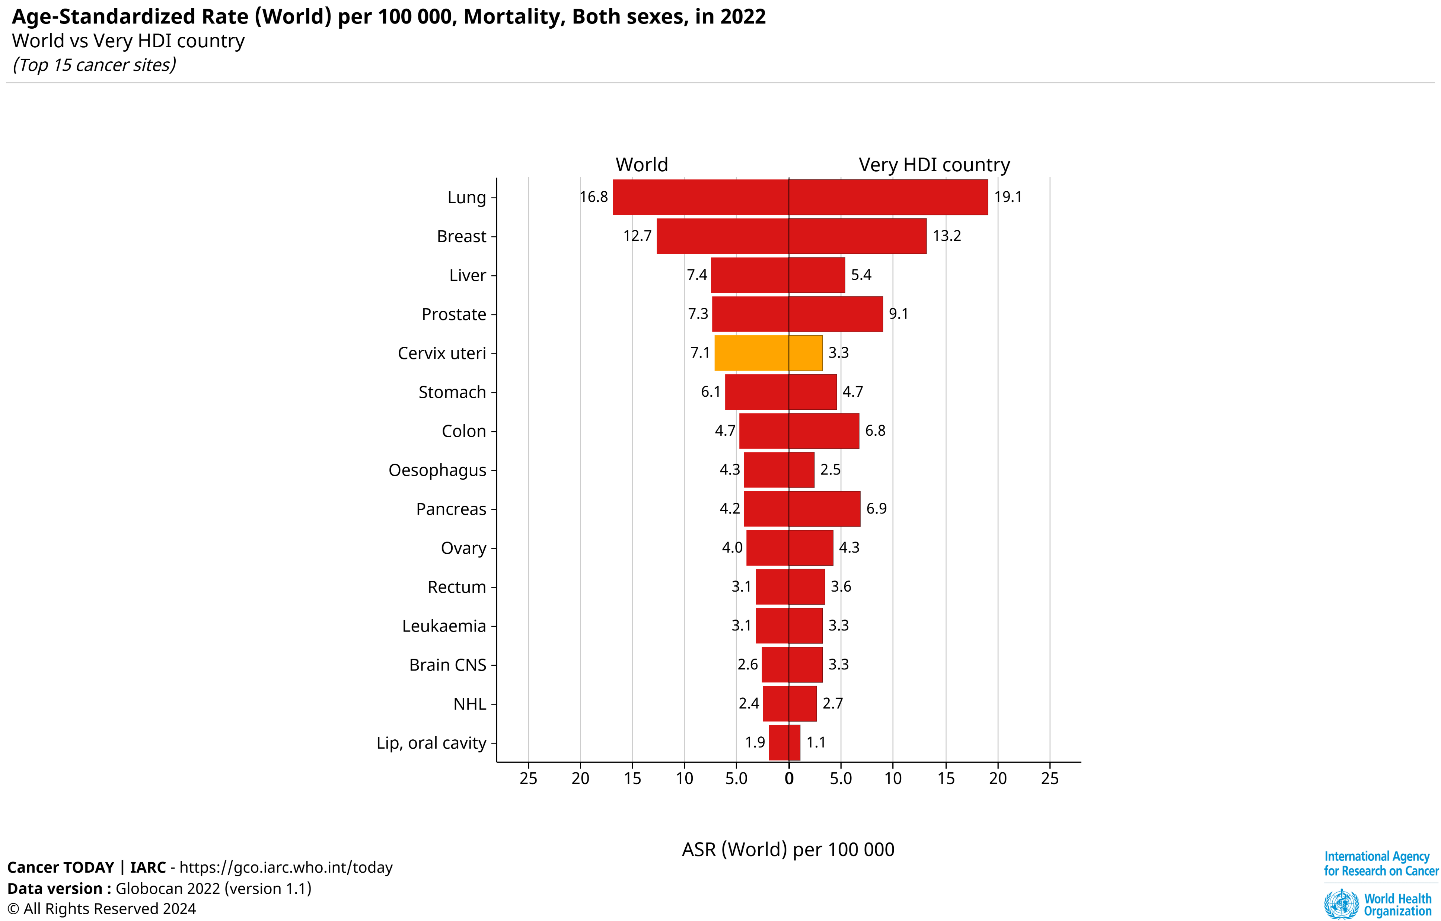

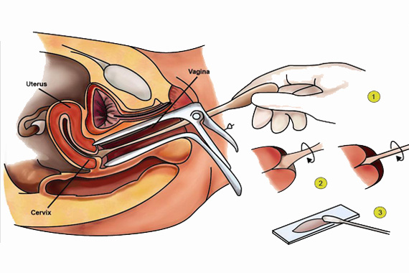
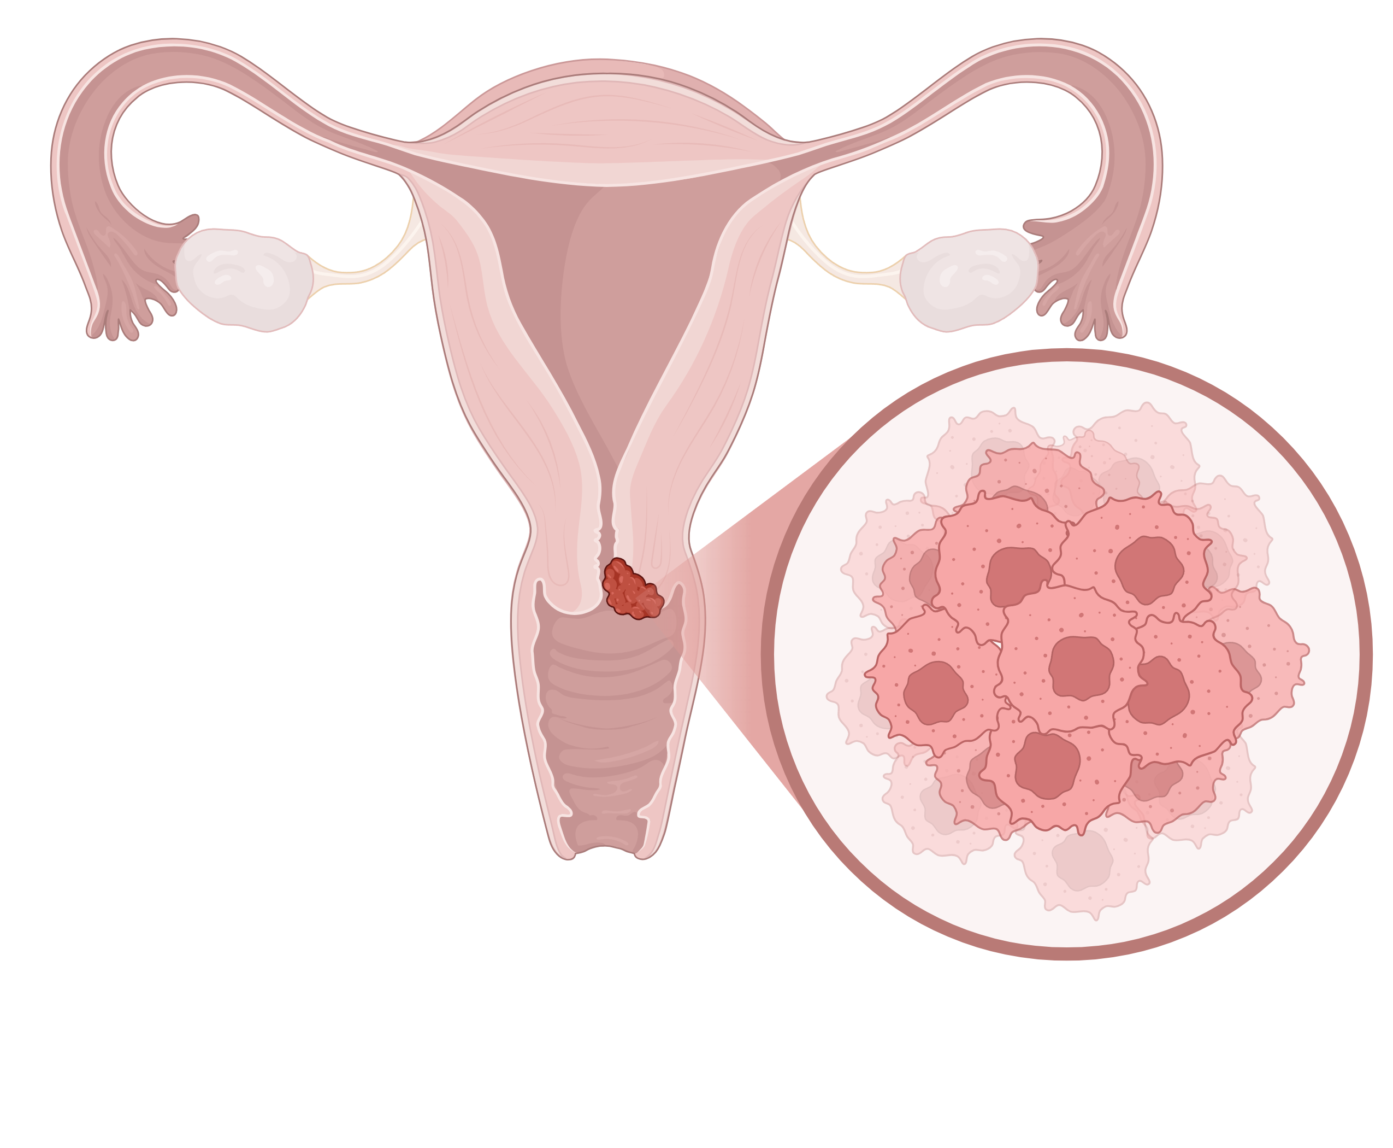
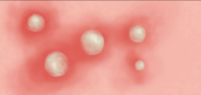
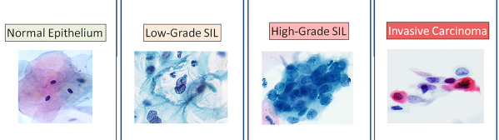
Introduction
Cervical Cancer: a Global health issue
Human Papilloma Virus (HPV) as the main causal factor of cervical cancer
Diagnosis and Screening
Papanicolau (PAP) test
Human Papilloma Virus (HPV)
High-risk HPV
Low-risk HPV
16, 18, 31, 33, 35, 45, 52, 58
6, 11
www.sukhipariwarclinic.com
Cytologic Evaluation
embryo.asu.edu
Cervical cancer
Genital Warts
https://www.sciencedirect.com/science/article/pii/S2374289521002980
Aziza Guellouz | Dynamic Readout Modalities for 3D Cell Models

Slide 5
Objectives
Identify specific morphological changes in the nucleus and cytoplasm that differentiate HPV 16, HPV 18, and HPV negative.
Investigate cytologic alterations in cervical cancer cells using Digital Holographic Microscopy (DHM).
Notes:
Now, when examining these cytological features, most cytological studies combine high-risk HPV types. But in our research, we’re taking a more focused approach by examining HPV types 16 and 18 separately.

Slide 6
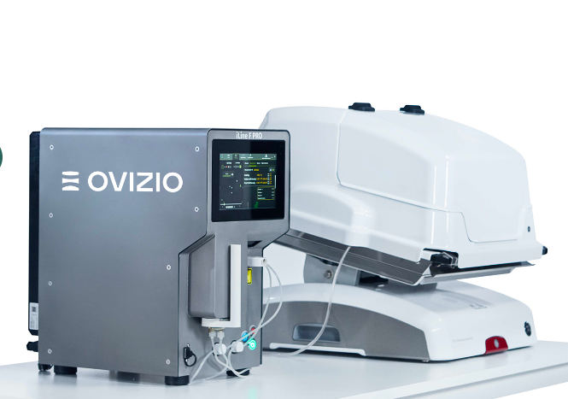
Digital Holographic Microscopy
Based on holography and interference of light waves
Captures the intensity of light +records phase shifts
3D, high-resolution images
Minimal sample preparation
Non-invasive
Label-free
https://ovizio.com/
Notes:
Digital Holographic Microscopy, or DHM, is an advanced imaging technique that allows us to…

Slide 7
Digital Holographic Microscopy
based on holography and interference of light waves
Captures the intensity of light +records phase shifts
3D, high-resolution images
Minimal sample preparation
Non-invasive
Label-free
https://ovizio.com/
Notes:
Digital Holographic Microscopy, or DHM, is an advanced imaging technique that allows us to…

Slide 8


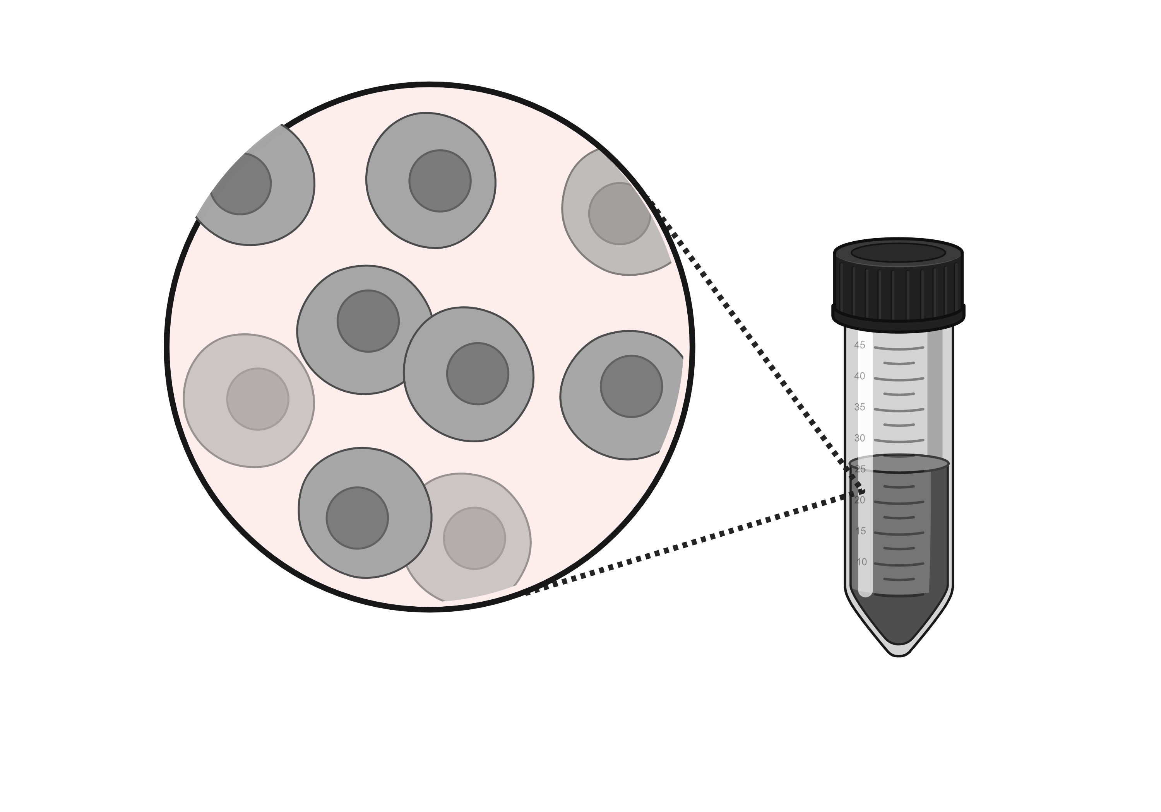
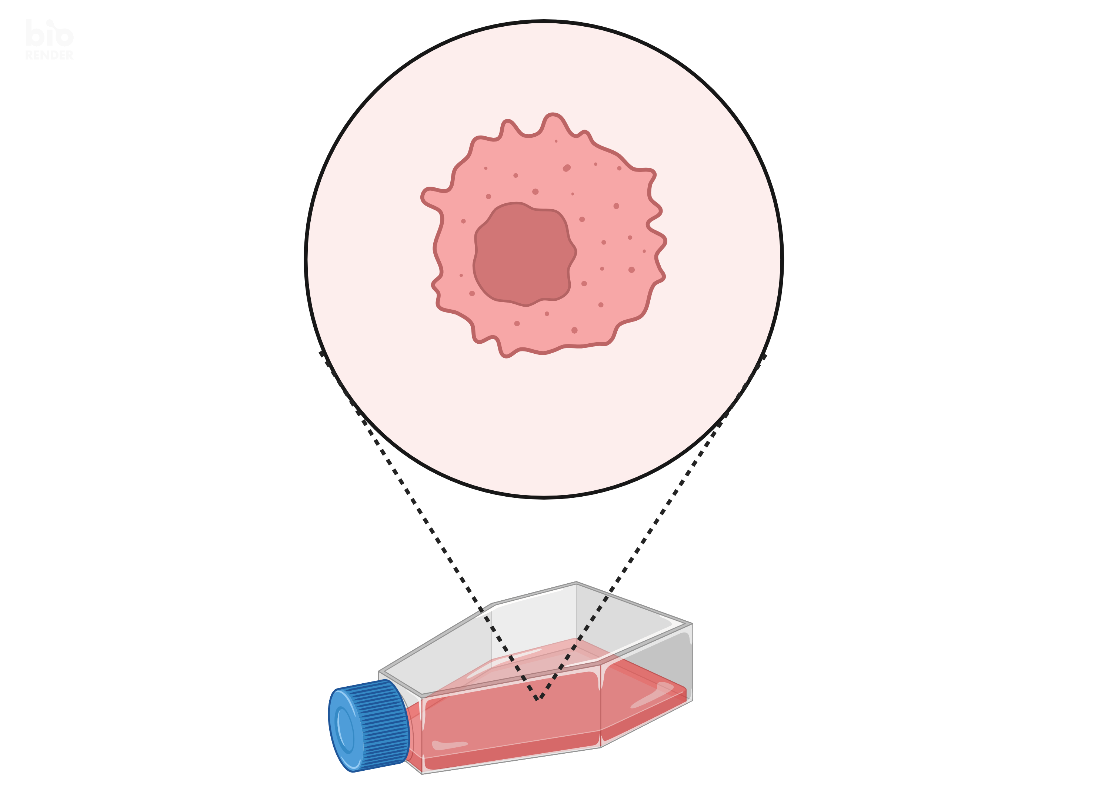
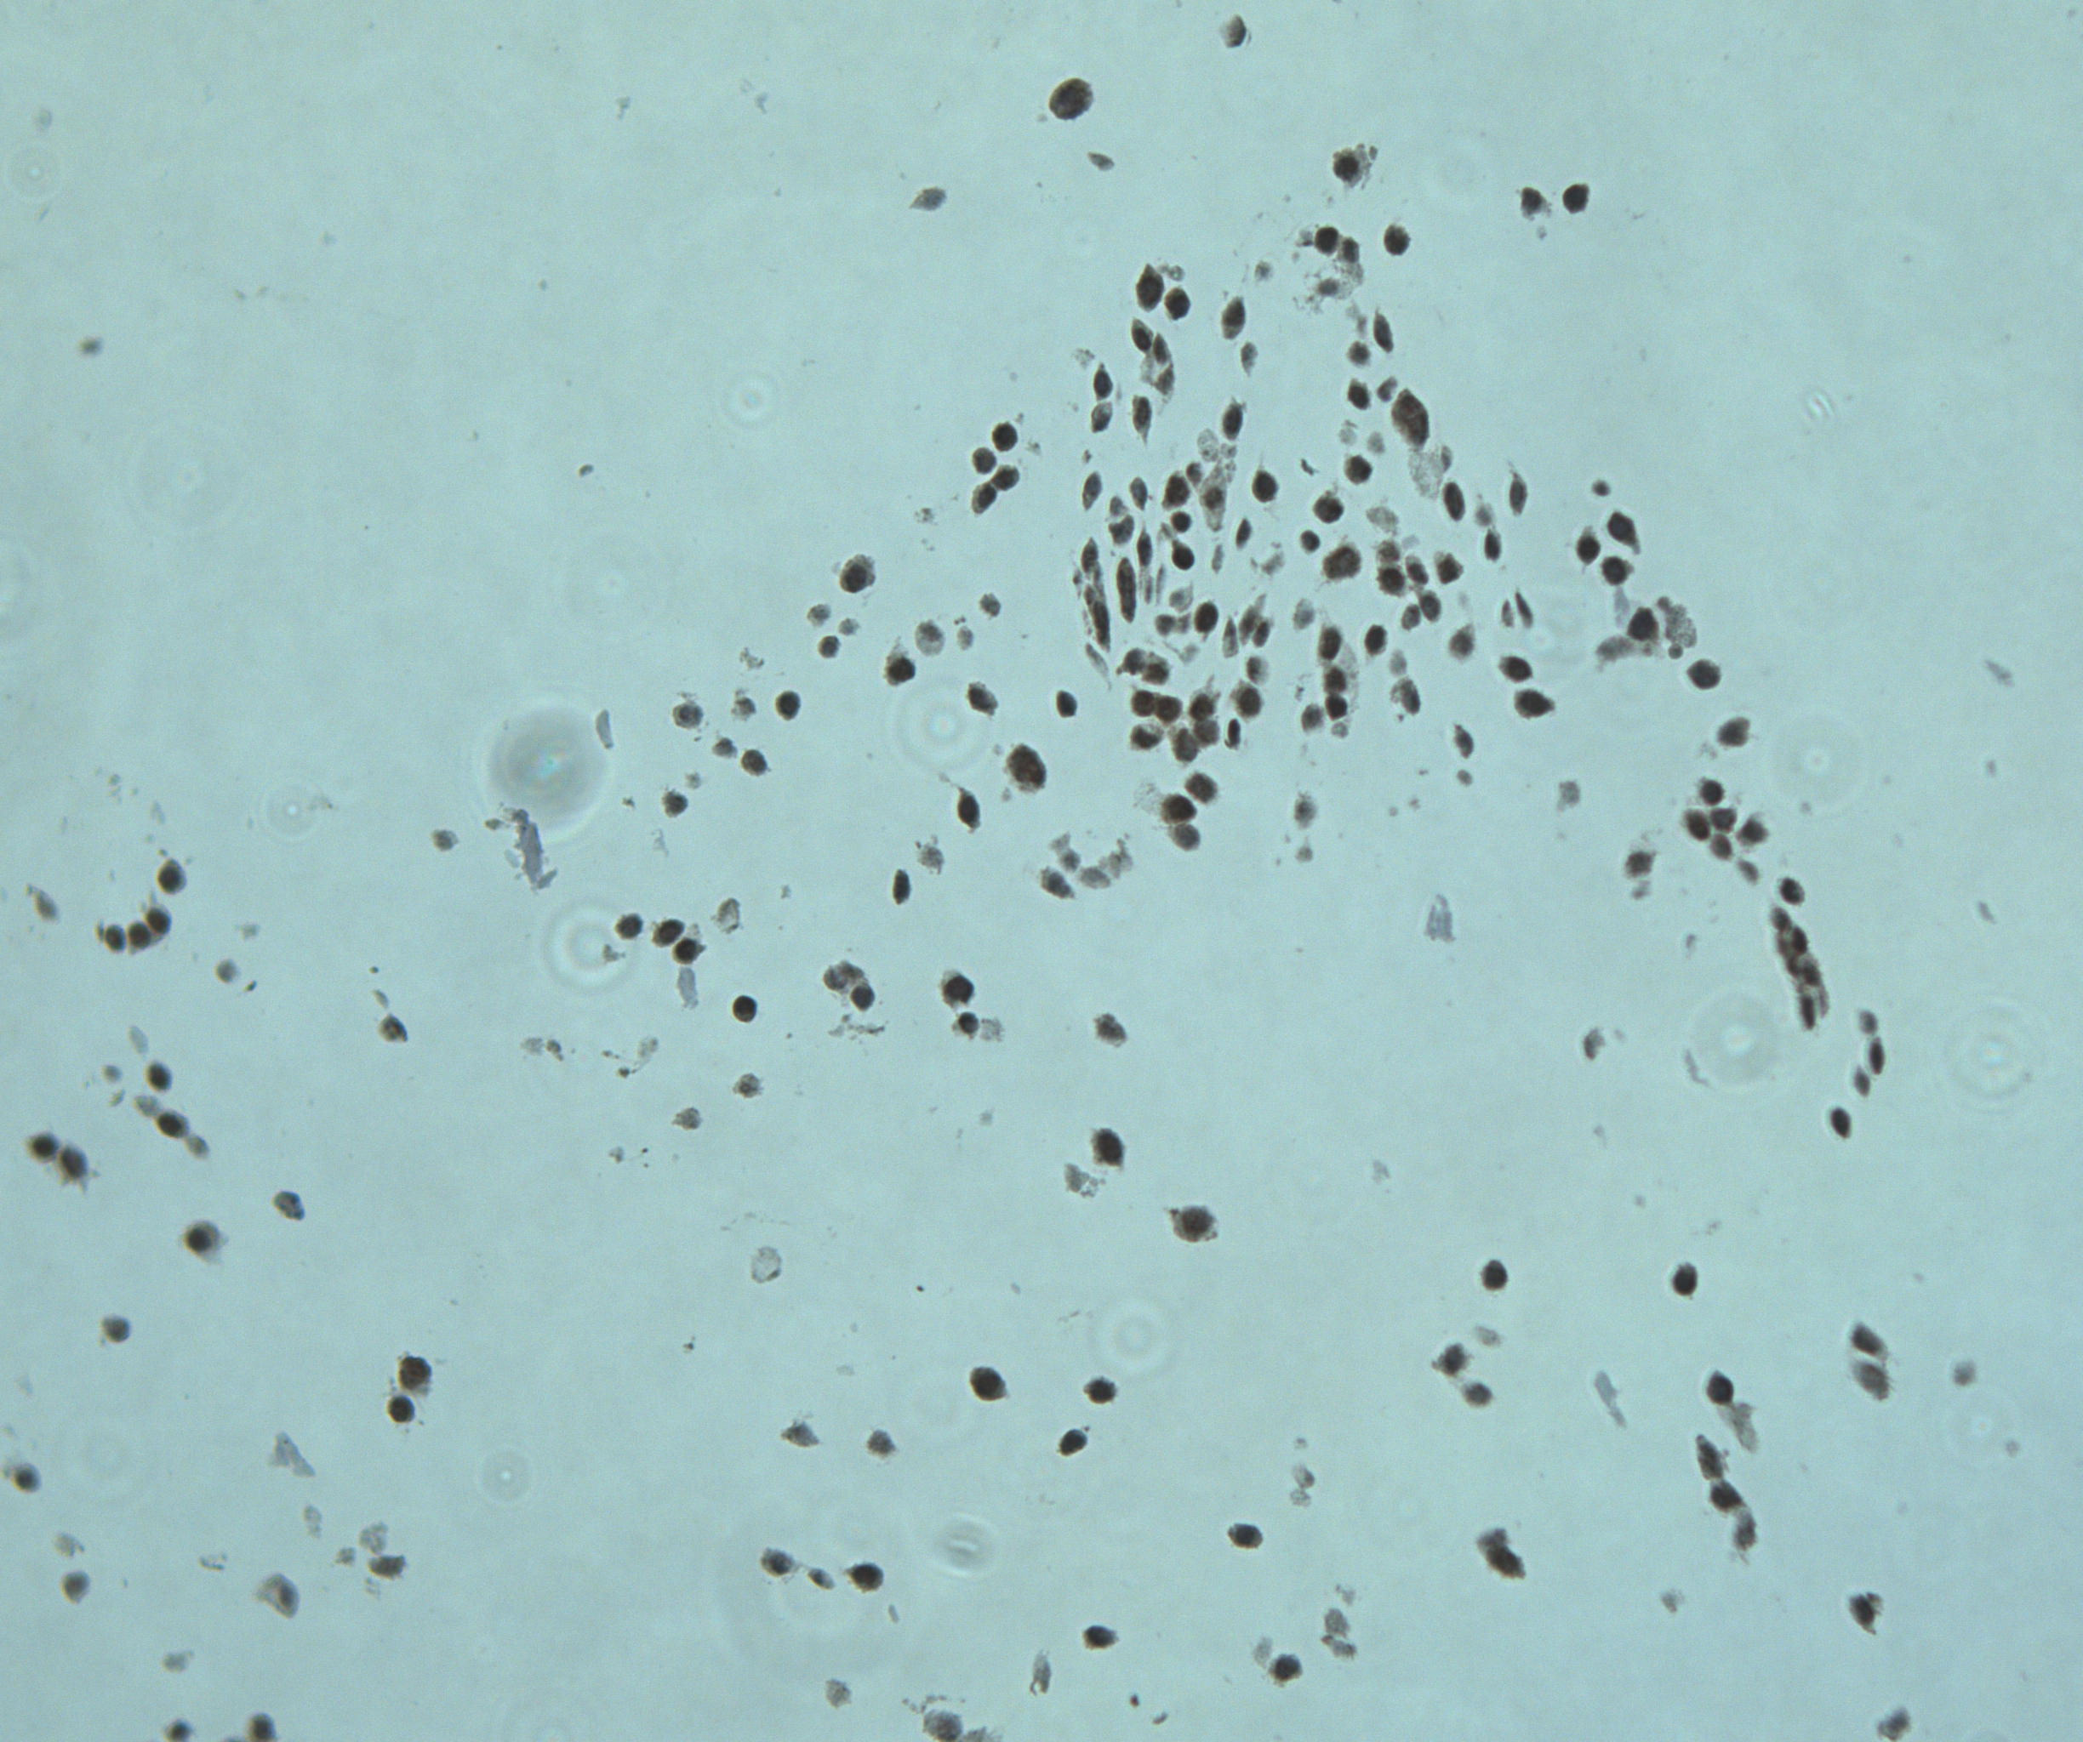
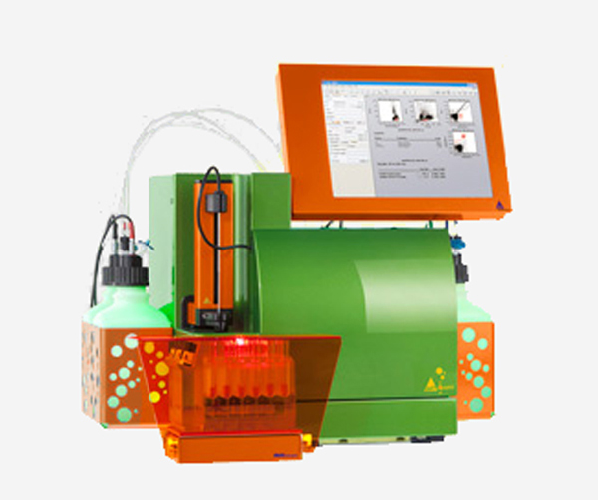
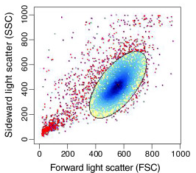
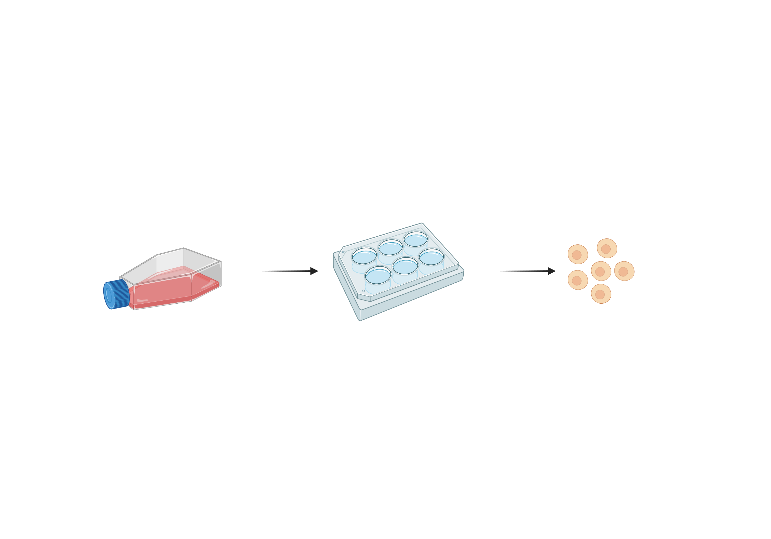

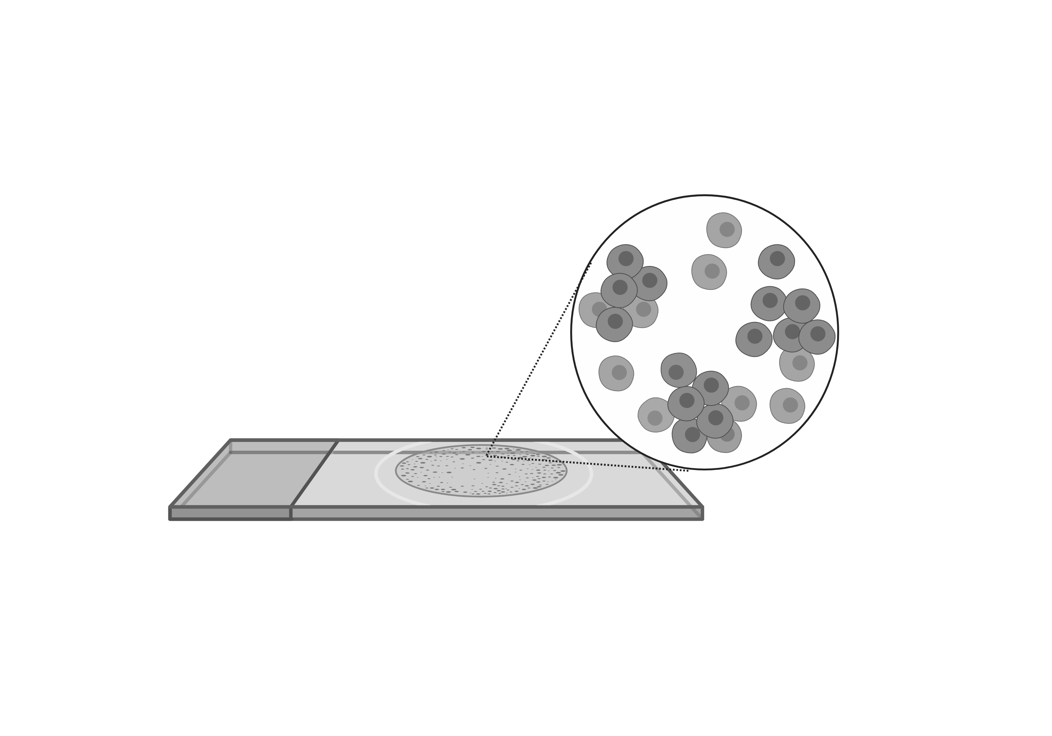

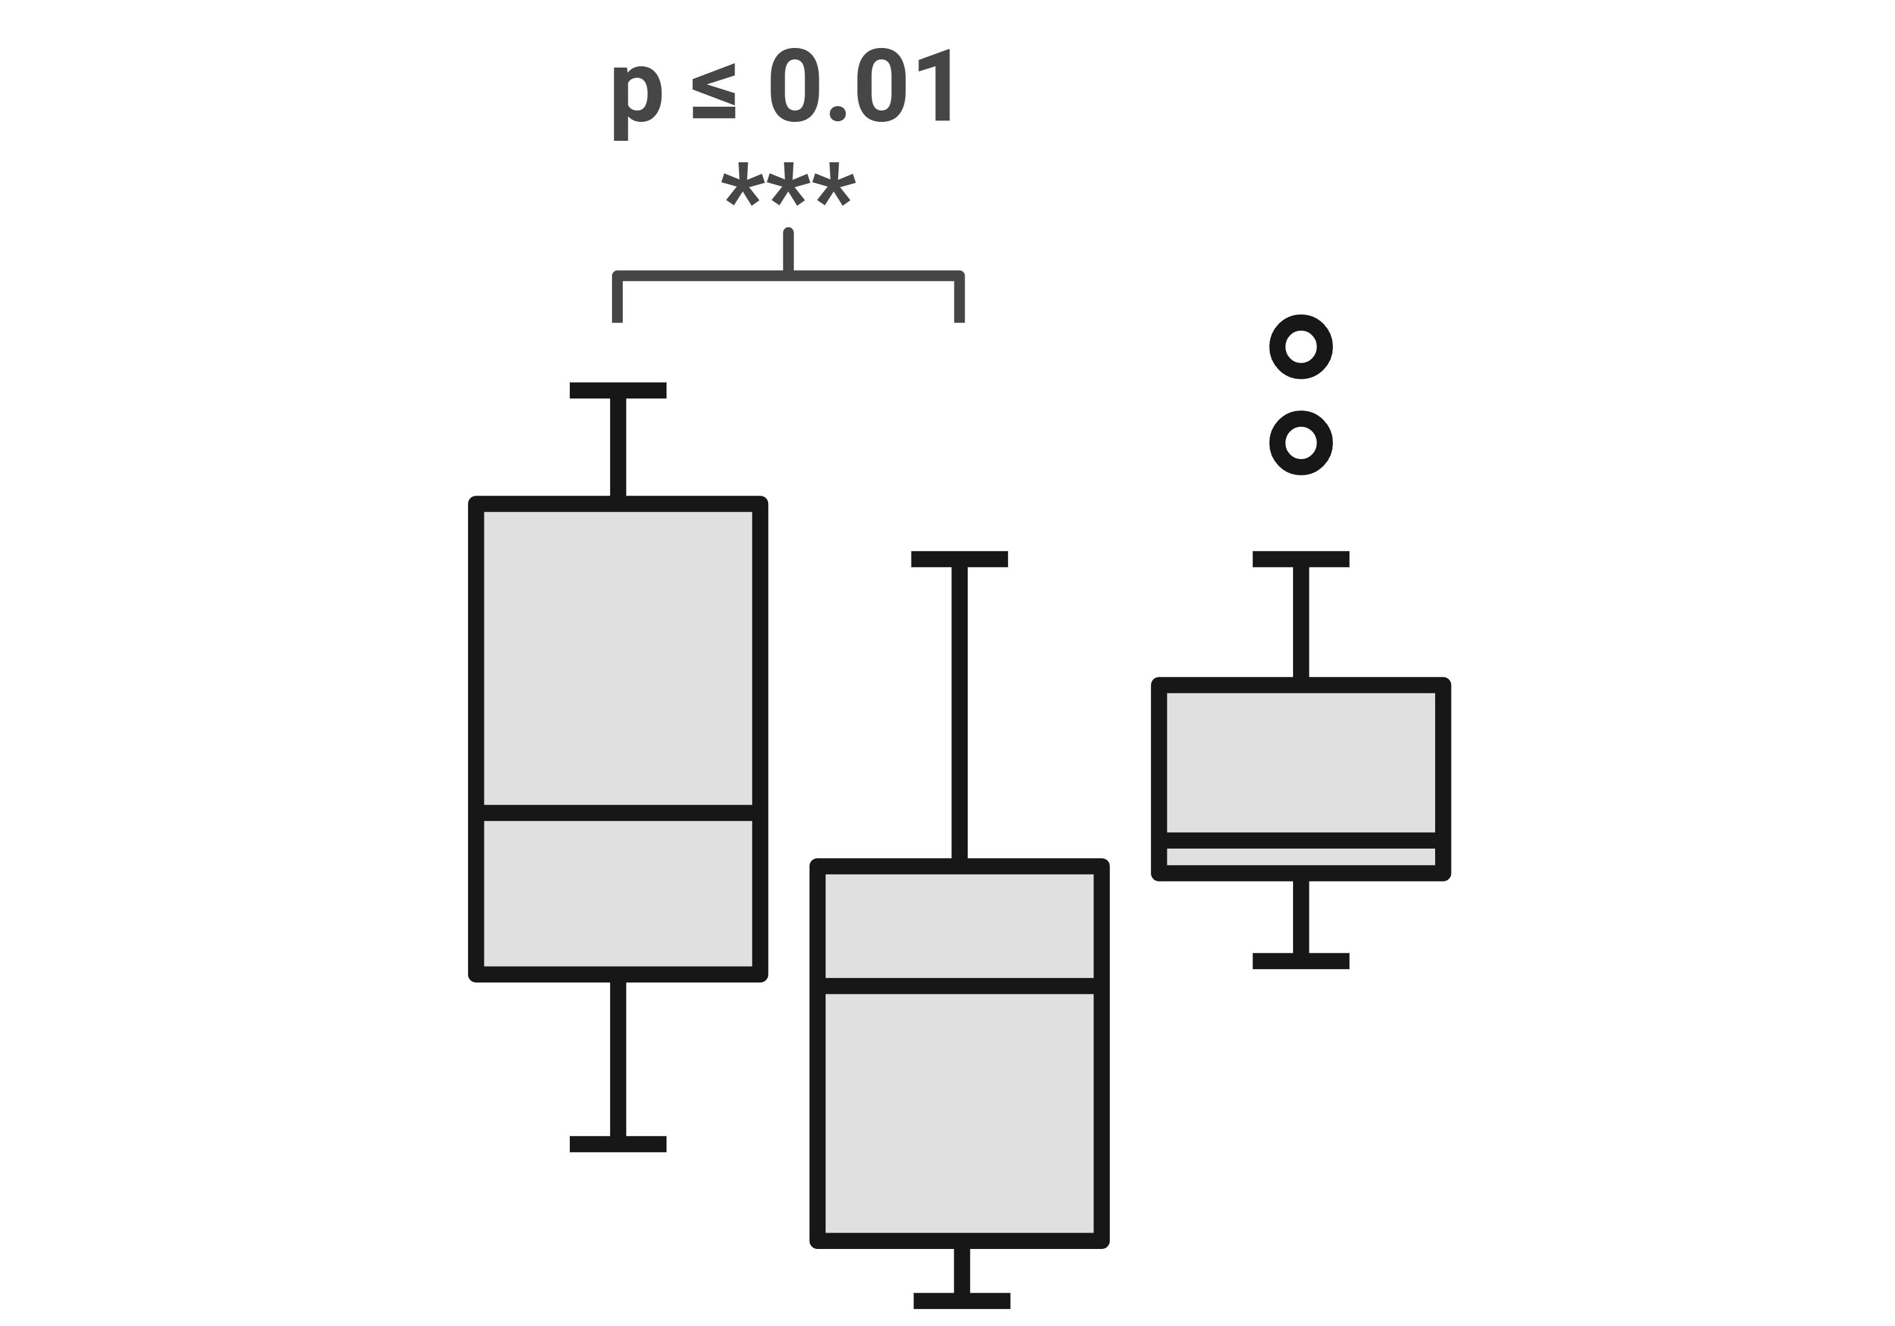
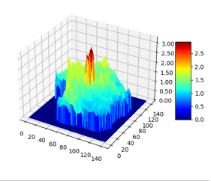
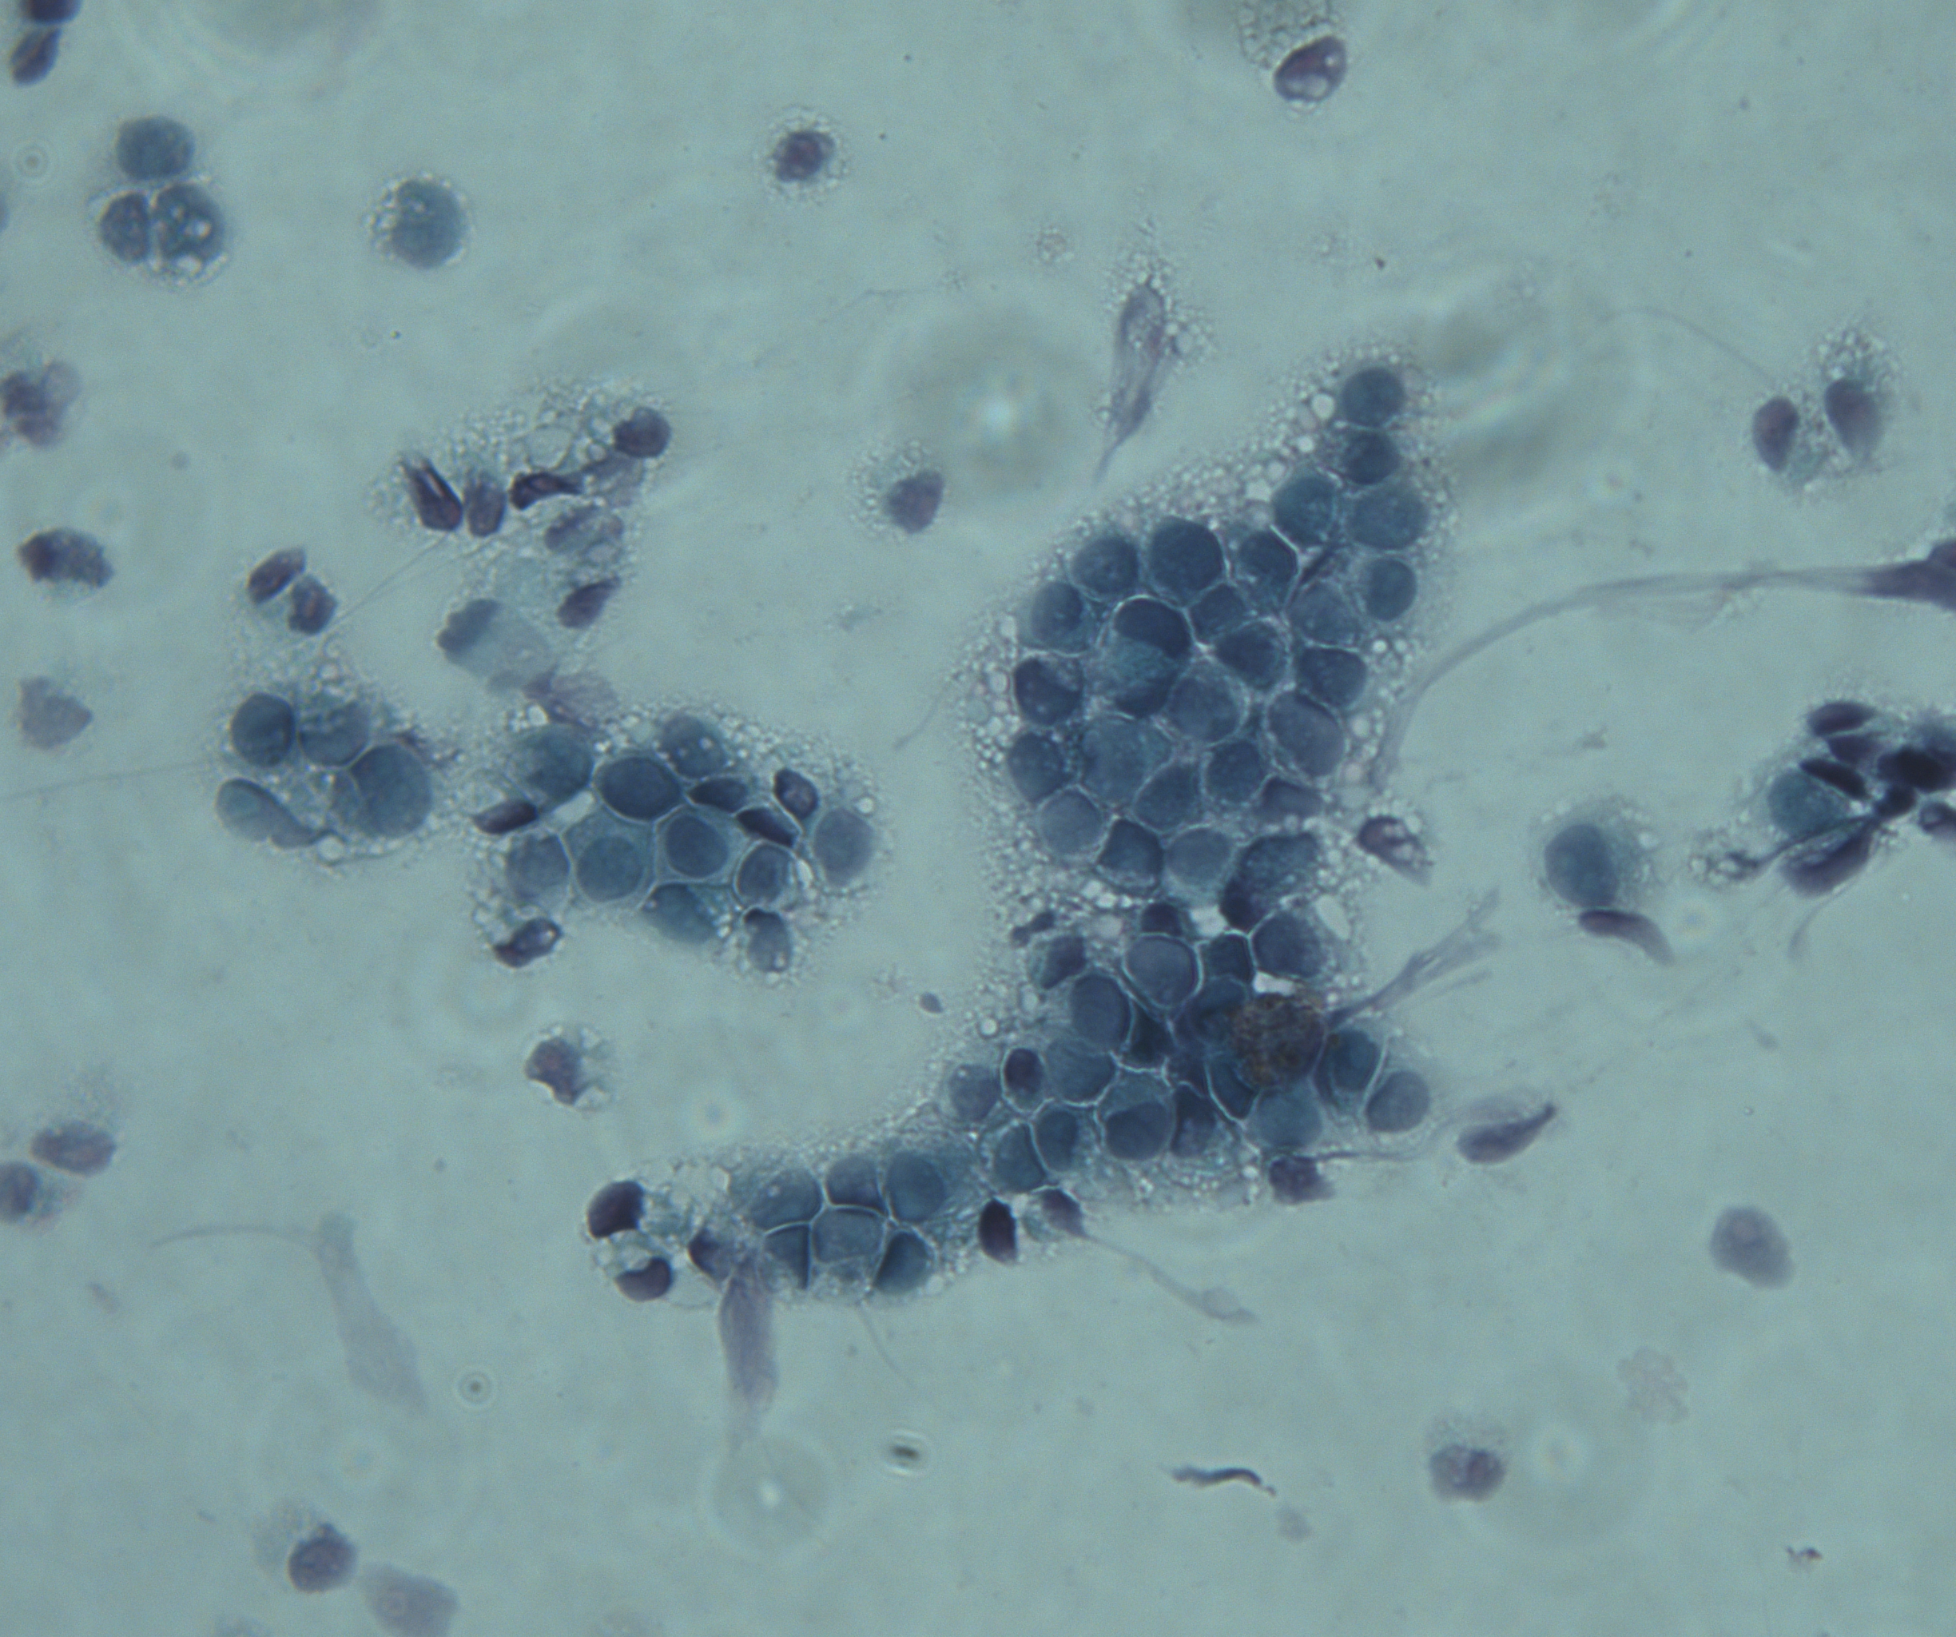
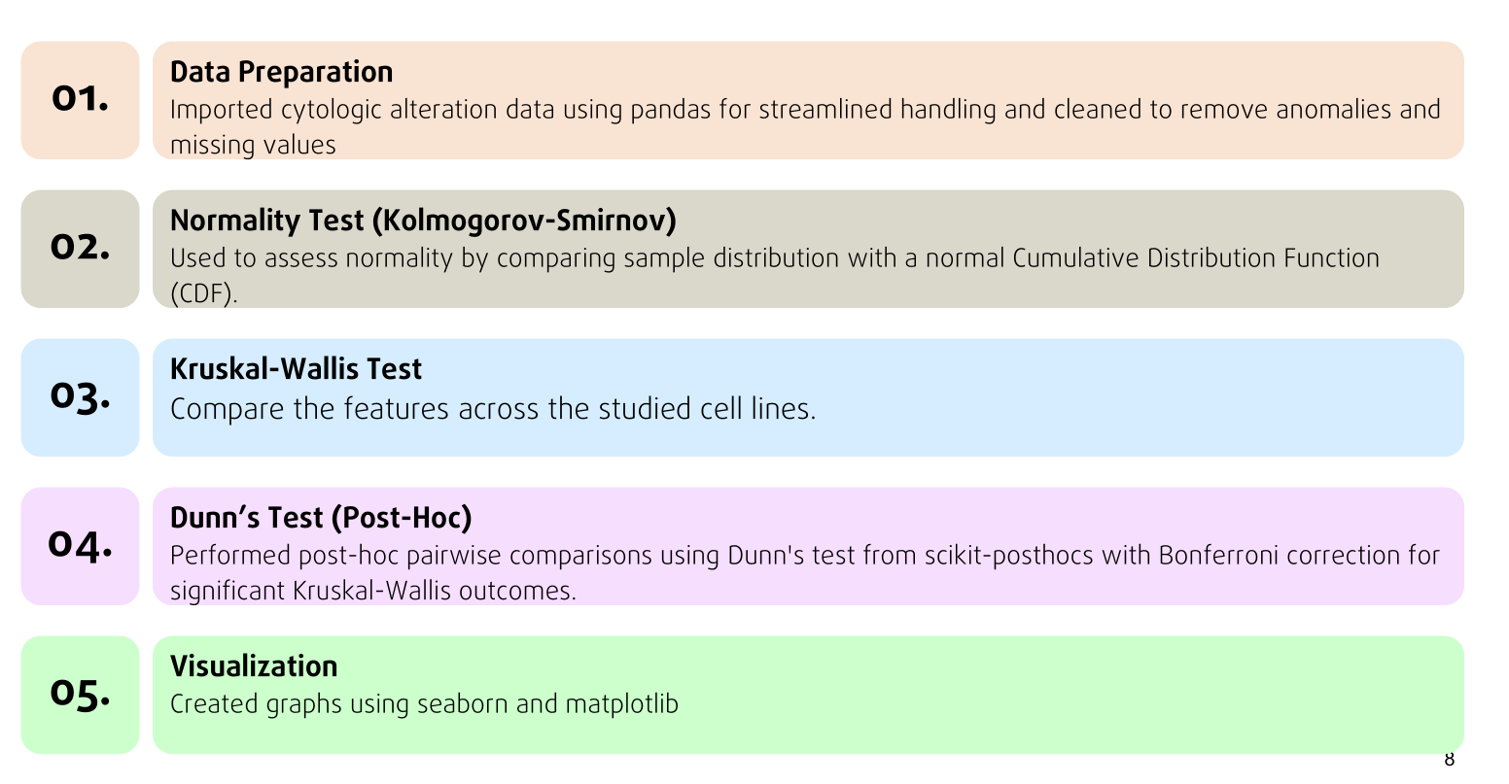
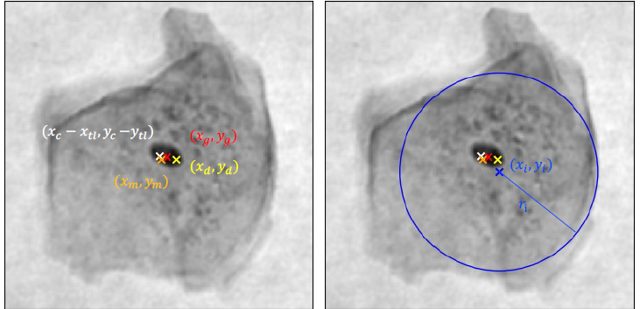
Methodology
1
2
3
4
Cell culture
Immunohistochemistry
Cell preprocessing
FACS Measurement
Cell line | HPV type
CaSki | HPV 16
SiHa | HPV 16
HeLa | HPV 18
C-33A | HPV negative
www.miltenyibiotec.com
DOI:10.1186/gb-2006-7-8-R77
5
6
7
8
DHM Measurement
PAP Staining
Image analysis, Cell detection, Feature extraction
Statistical analysis
https://ovizio.com/
Julia Sistermanns - Creating the Database for Liquid Biopsy

Slide 9
Statistical analysis
01.
Data Preparation
Imported cytologic alteration data using pandas for streamlined handling and cleaned to remove anomalies and missing values
02.
Normality Test (Kolmogorov-Smirnov)
Used to assess normality by comparing sample distribution with a normal Cumulative Distribution Function (CDF).
03.
Kruskal-Wallis Test
Compare the features across the studied cell lines.
04.
Dunn’s Test (Post-Hoc)
Performed post-hoc pairwise comparisons using Dunn's test from scikit-posthocs with Bonferroni correction for significant Kruskal-Wallis outcomes.
05.
Visualization
Created graphs using seaborn and matplotlib

Slide 10
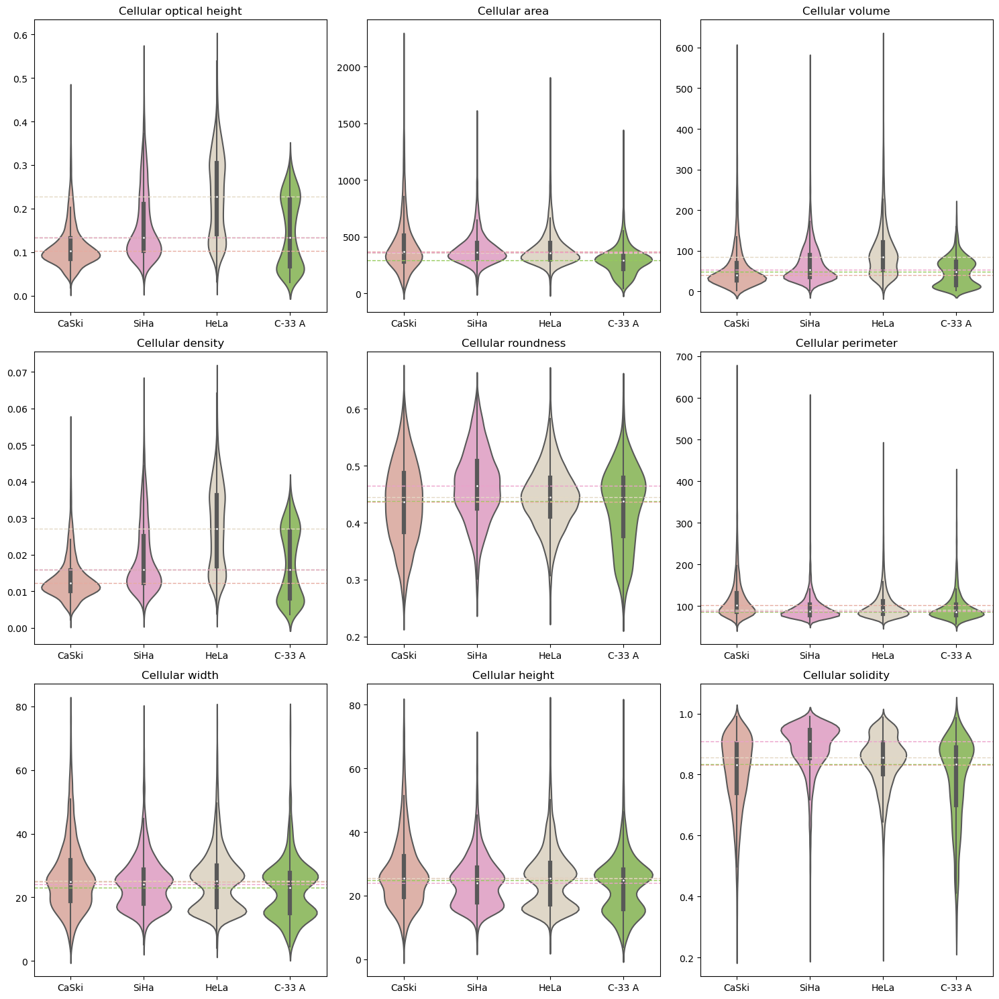
Results
Cellular features
Feature | Kruskal-Wallis p-value
Cellular width (μm) | p<0.001
Cellular height (μm) | p<0.001
Cellular optical height (μm) | p<0.001
Cellular volume (μm³) | p<0.001
Cellular area (μm²) | p<0.001
Cellular roundness | p<0.001
Cellular perimeter (μm) | p<0.001
Cellular solidity | p<0.001
Cellular density (μm) | p<0.001

Slide 11
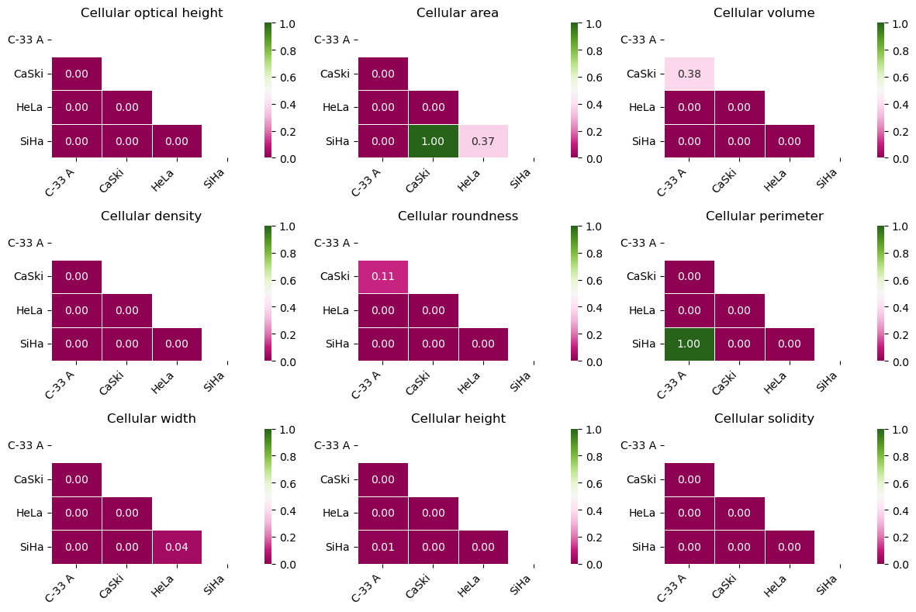
Results
Cellular features
Dunn’s Test (Post-Hoc)

Slide 12
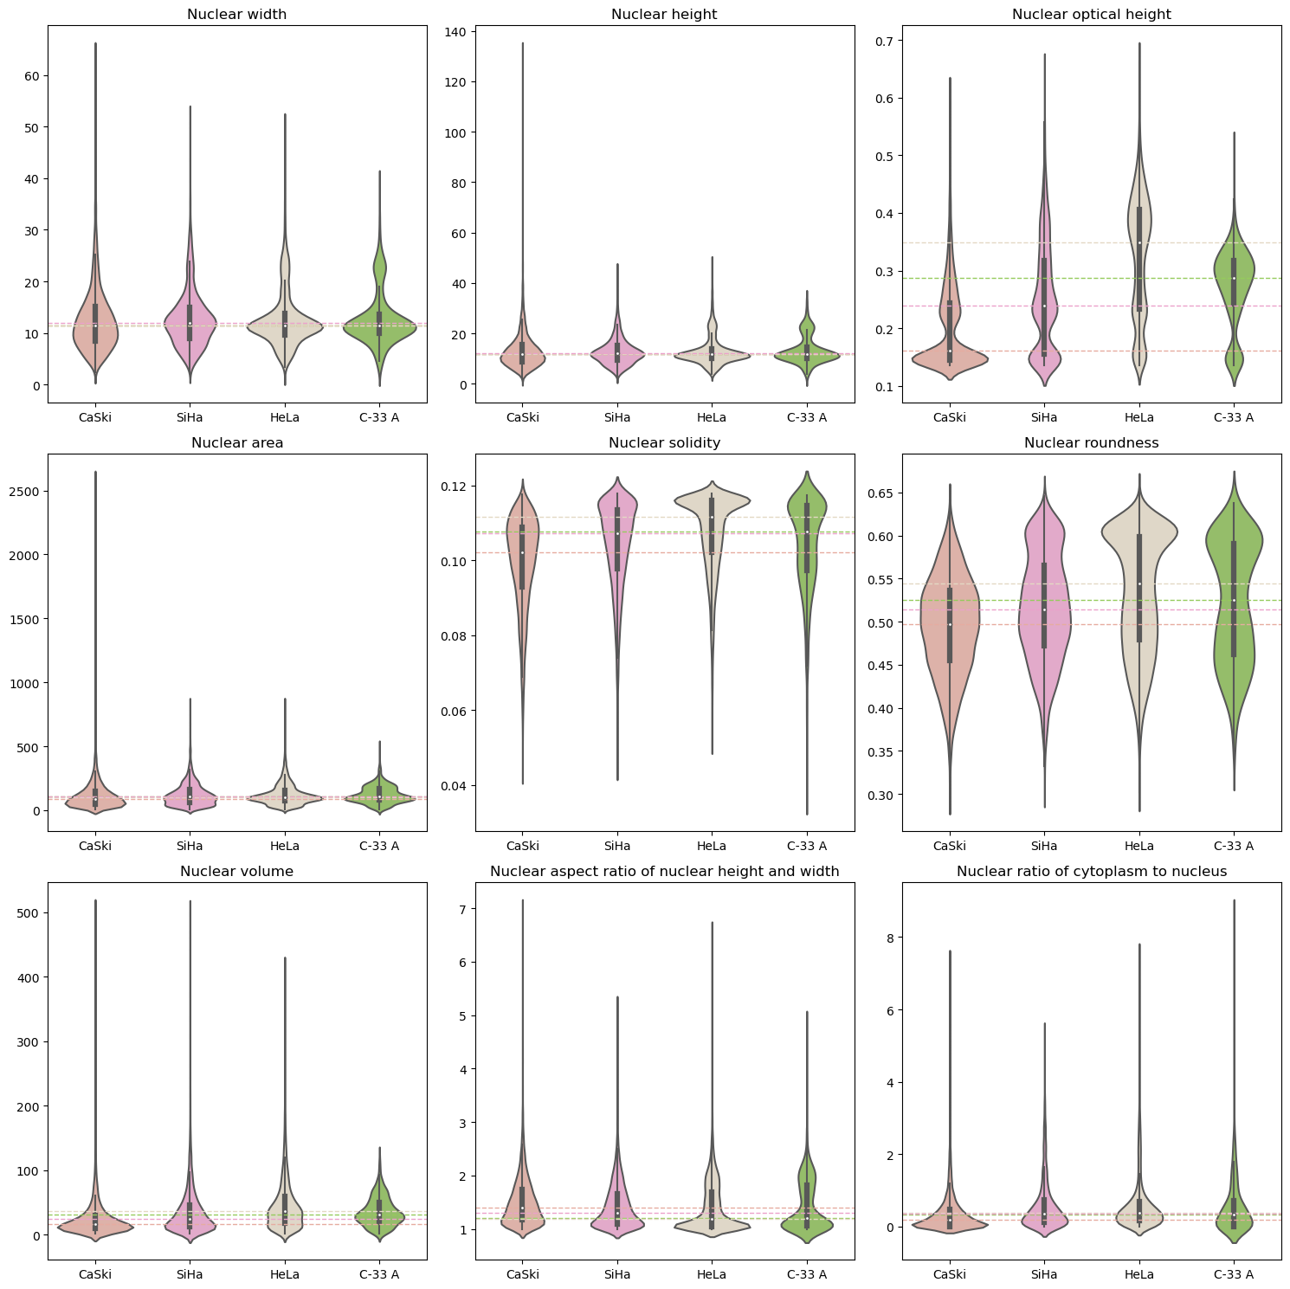
Results
Nuclear features
Feature | Kruskal-Wallis p-value
Nuclear width (μm) | p<0.001
Nuclear height (μm) | p<0.001
Nuclear optical height (μm) | p<0.001
Nuclear volume (μm³) | p<0.001
Nuclear area (μm²) | p<0.001
Nuclear roundness | p<0.001
Nuclear solidity | p<0.001
Aspect ratio of nuclear height and width | p<0.001
Ratio of cytoplam to nucleus | p<0.001

Slide 13
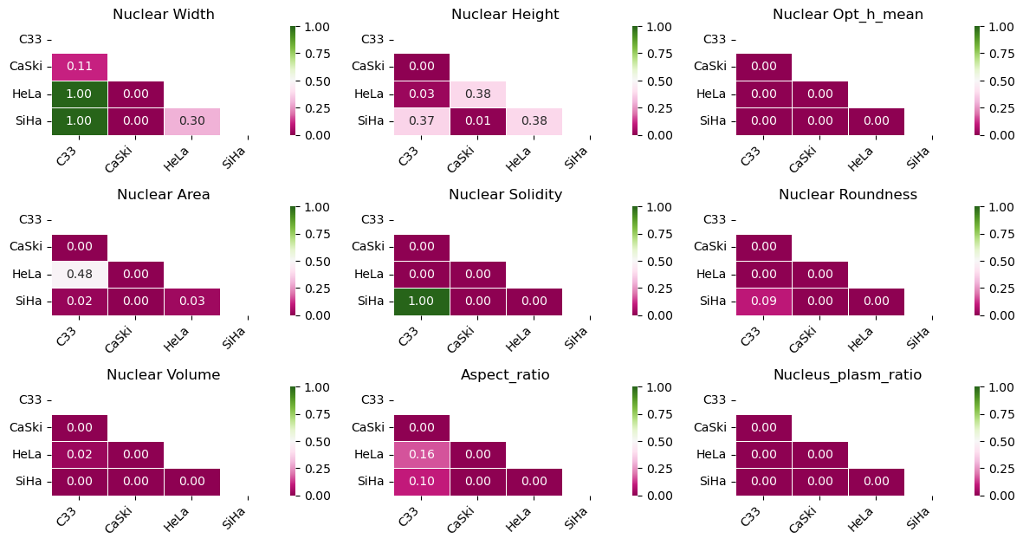
Results
Nuclear features
Dunn’s Test (Post-Hoc)

Slide 14
Summary
Key Takeaways:
Significant differences were observed across the four cell lines: SiHa, CaSki, HeLa, and C-33A.
No clear grouping fully separates HPV-positive from HPV-negative cell lines.

Slide 15
Outlook
Investigating other cytological features to enhance HPV-16 and HPV-18 differentiation (ongoing integration of literature-based markers like the presence of micronuclei, karyorrhexis, and perinuclear halo).
Incorporating patient-derived cervical smears (instead of commercialized cell lines) can capture a wider range of cytological changes caused by HPV → improve diagnostic accuracy and create more realistic baseline values for identifying abnormalities.

Slide 16
Assessing cancer organoid phenotypes using Electric Impedance Spectroscopy (EIS)

Slide 17


Introduction
Organoids
Electrical Impedance Spectroscopy (EIS)
Notes:
Electrical impedance spectroscopy (EIS) is a technique used to measure the resistance and reactance of a material
allowing the analysis of its electrical properties, such as conductivity and capacitance.

Slide 18
Objectives
Use Nanion Technologies’ impedance measurement device, AtlaZ, to monitor organoid cultures.
Investigate the influence of individual factor in the system (cell density, drug treatment).

Slide 19
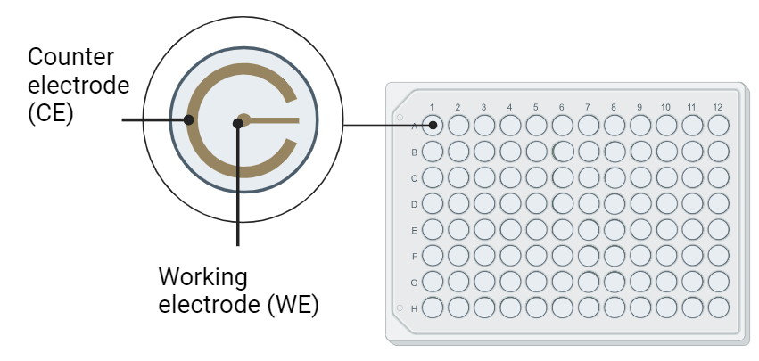
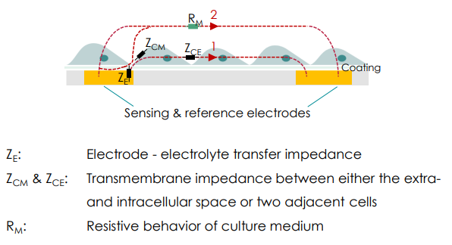
Working principle of the AtlaZ system
Nanion Technologies
BioRender.com
Notes:
The AtlaZ system applies the concept of electrical impedance to assess cellular characteristics within each well. It operates by applying a controlled voltage between two electrodes: the working electrode (WE) and the counter electrode (CE). This voltage induces a current, and by measuring the resulting impedance, we gain insights into the cellular environment within the well.
To facilitate these measurements, the NSPZ96 plates from Nanion Technologies are specifically designed for the AtlaZ system. These transparent plates contain embedded electrodes at the base of each well,

Slide 20



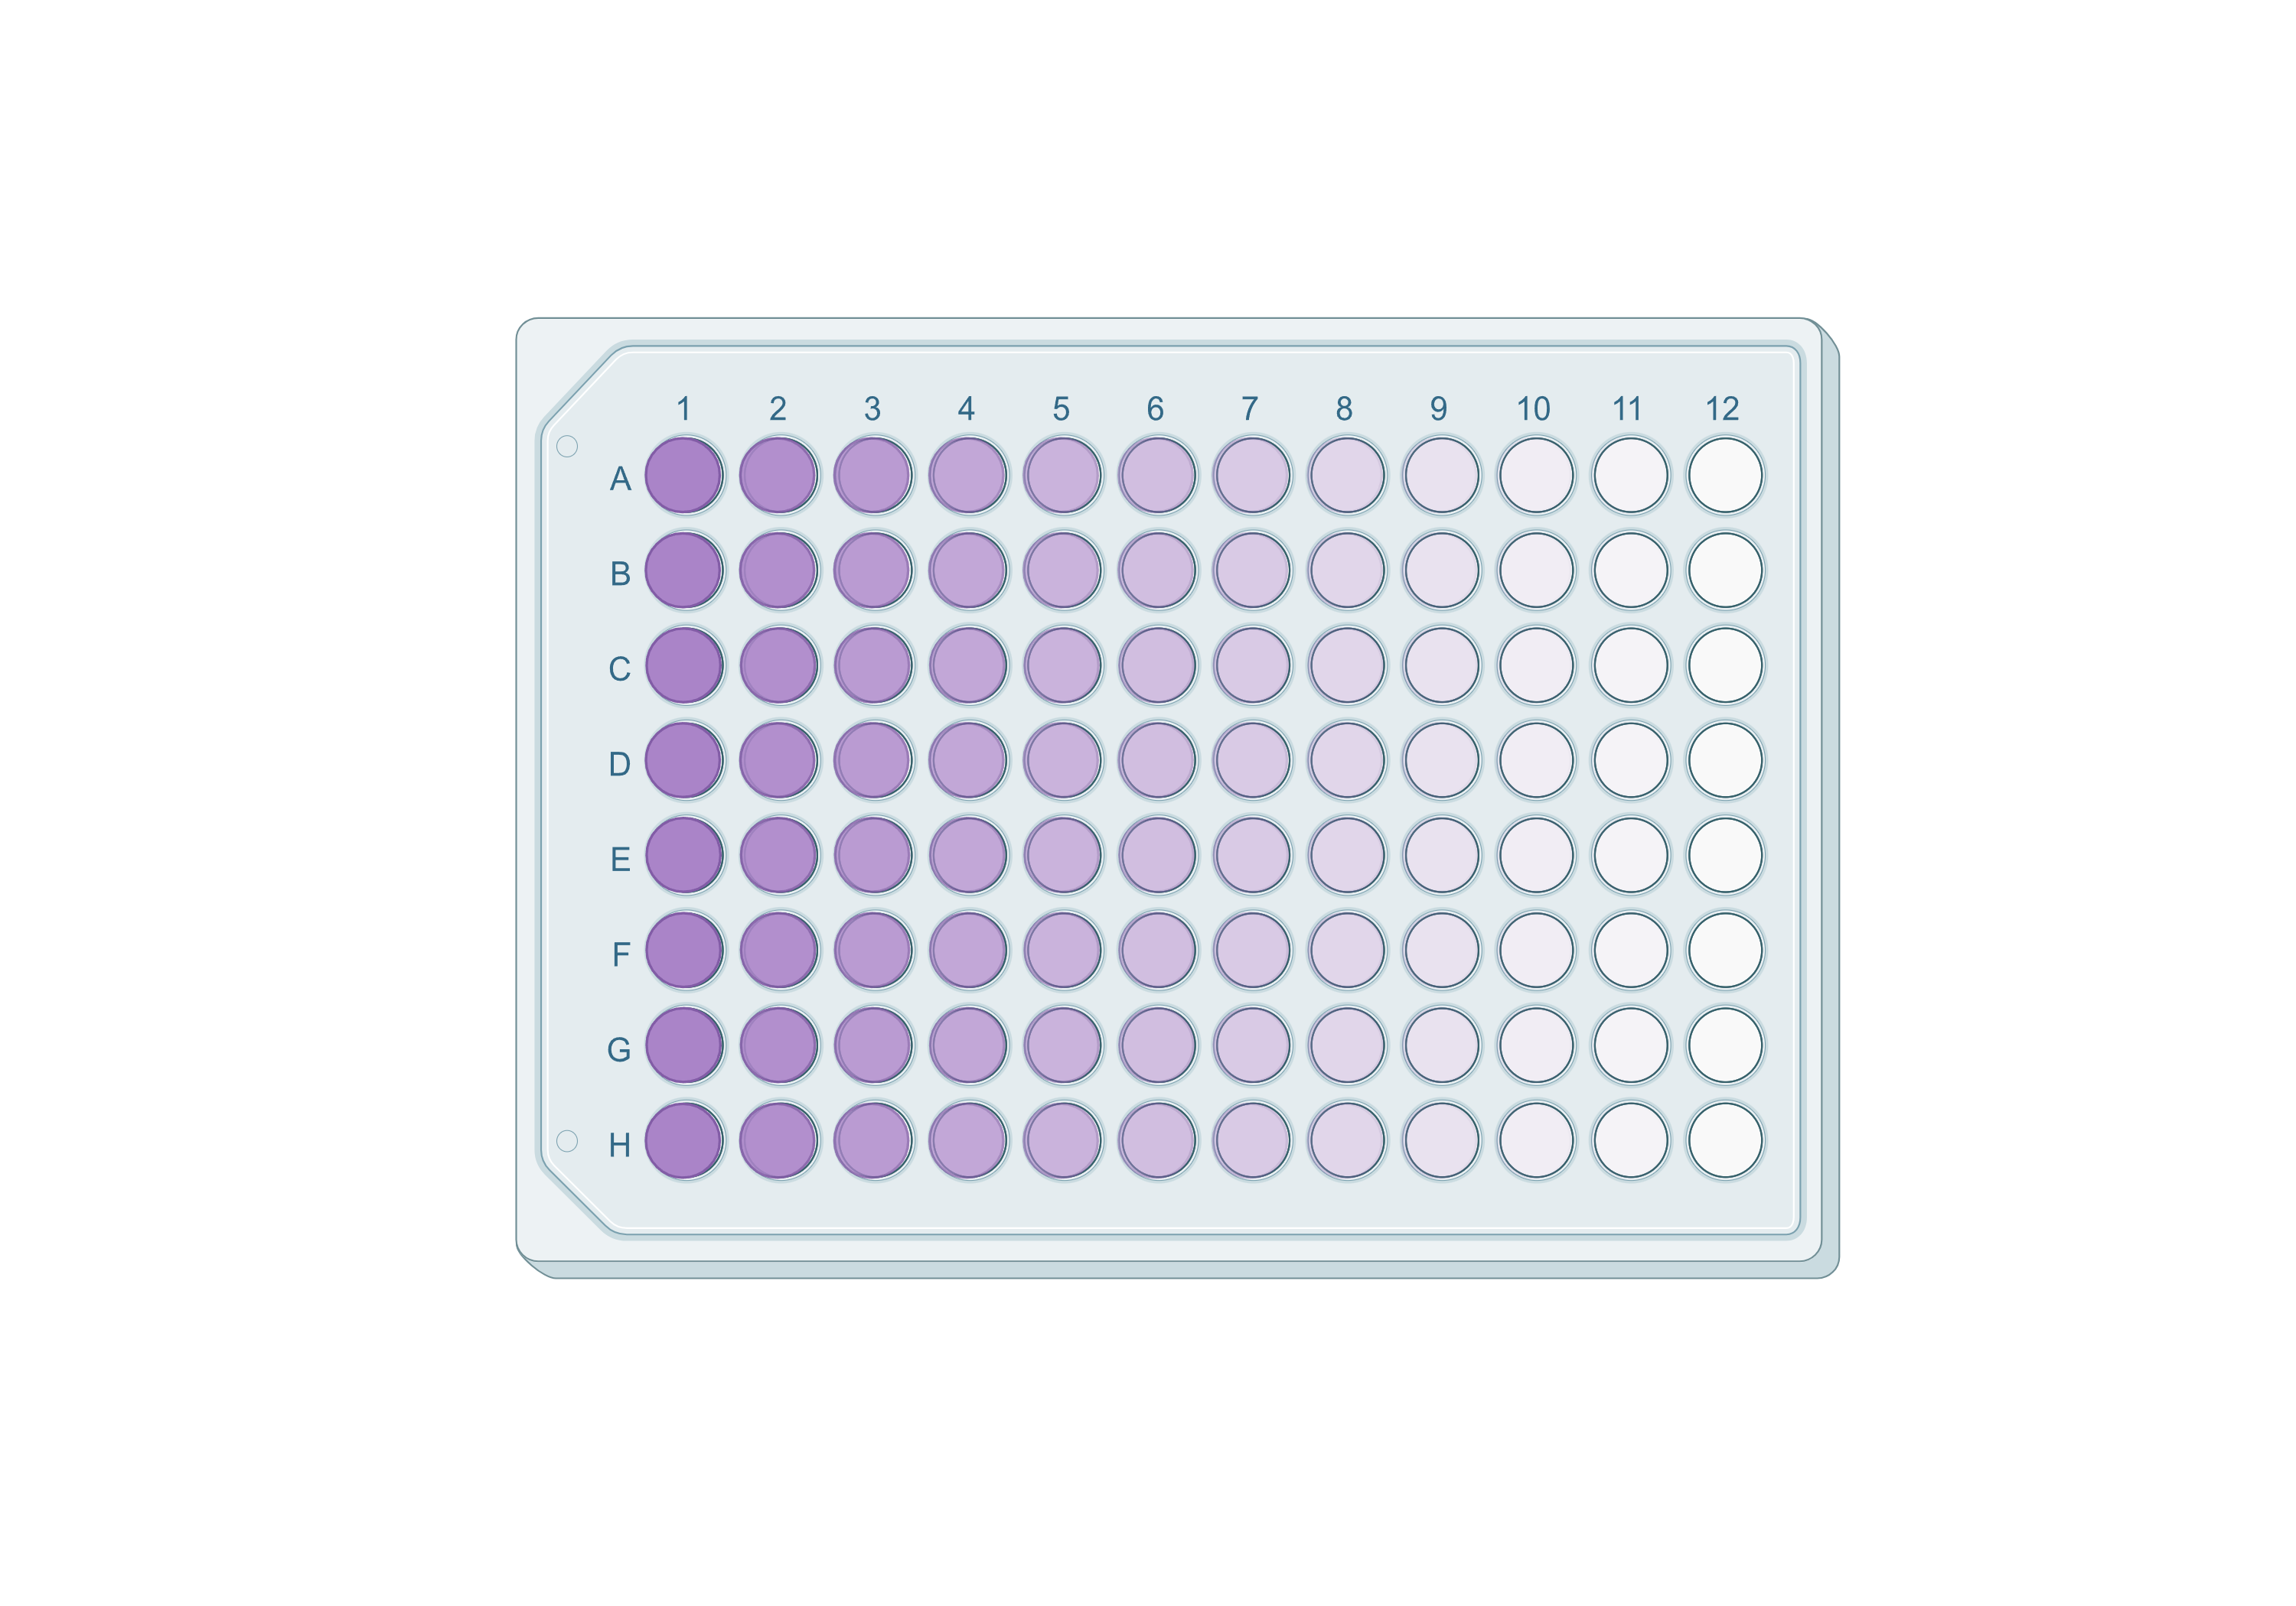
Methodology
Organoid culture
Cell preprocessing
Cell plating into the NSPZ96 plates (embedded electrodes to allow for impedance measurements)
Day 1: Start of continuous, real-time impedance measurement
Addition of drug treatment (Cycloheximide)
Day 4
Endpoint measurement: Viability assay
Day 7: End of impedance measurement
Statistical analysis

Slide 21
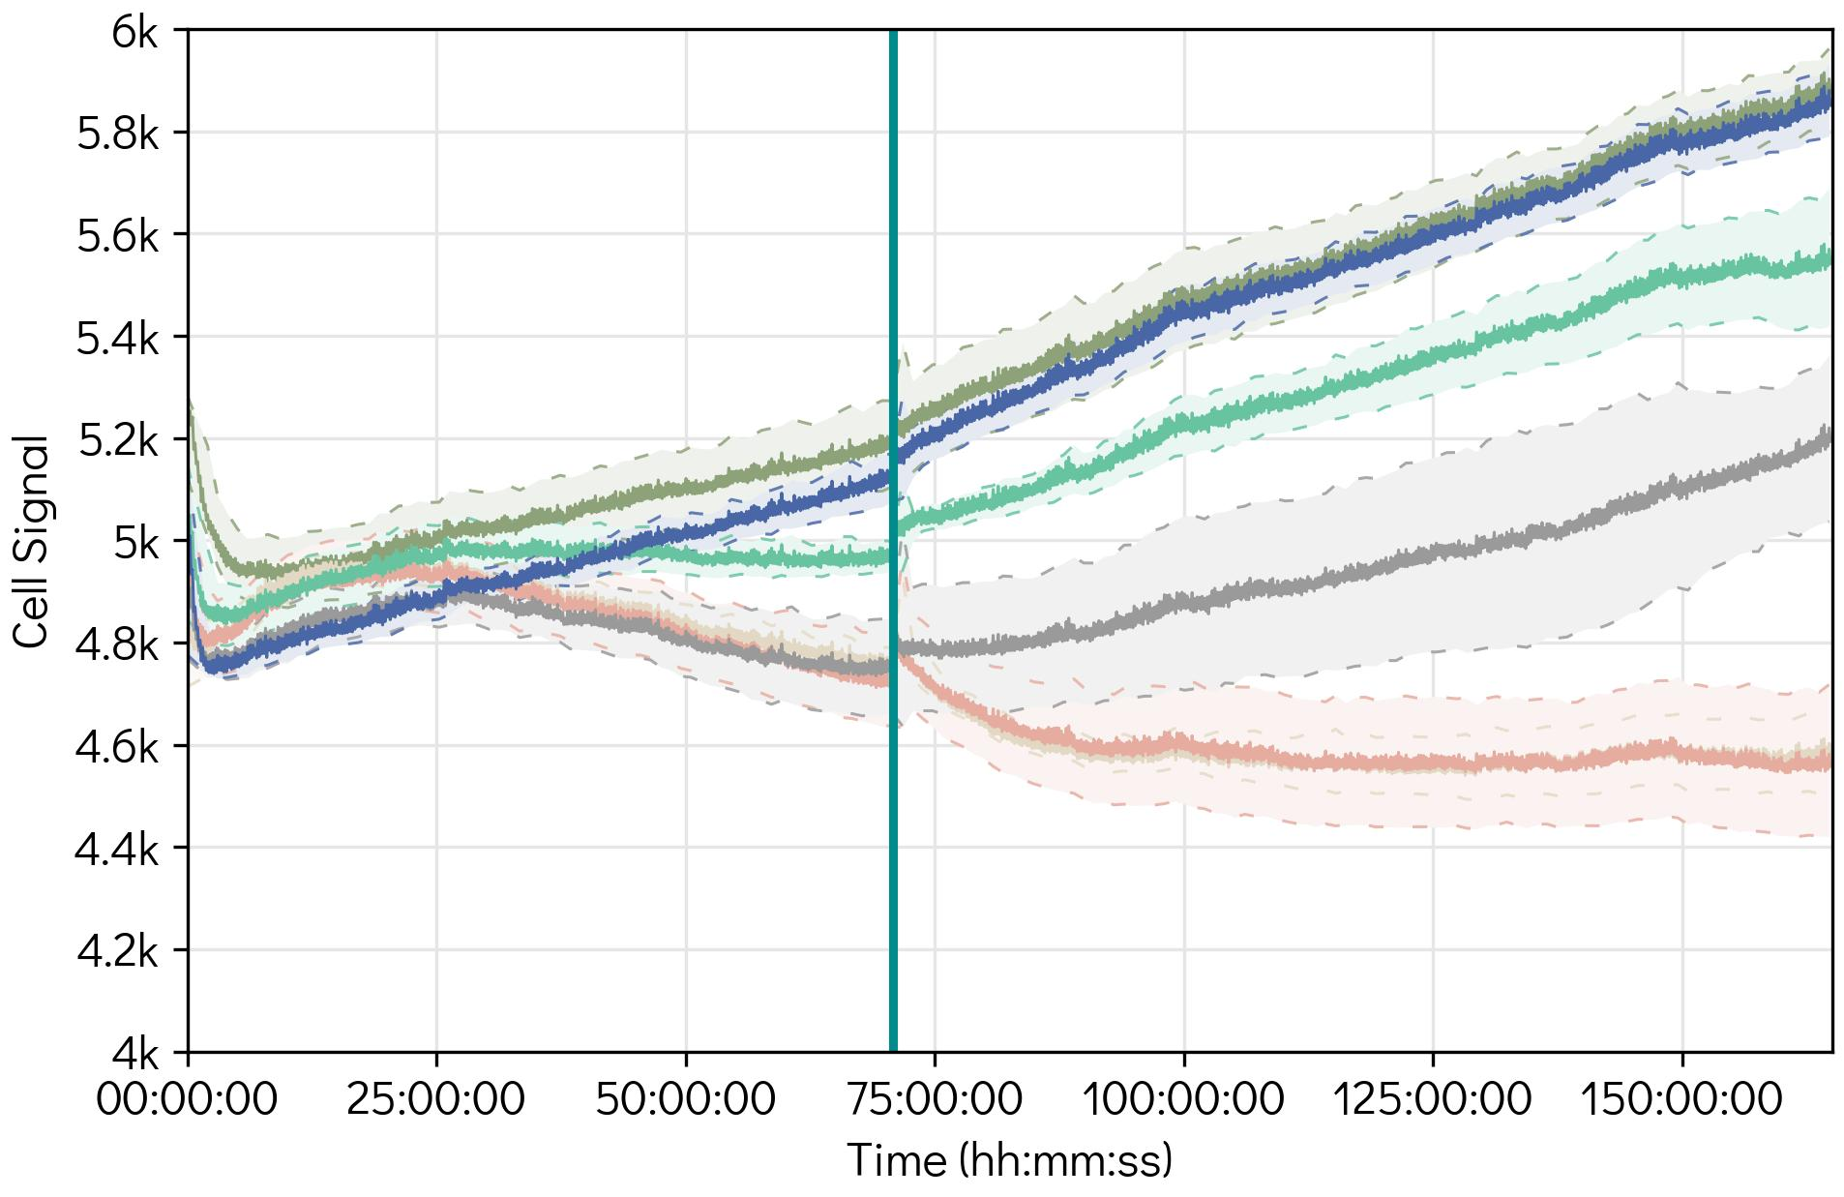
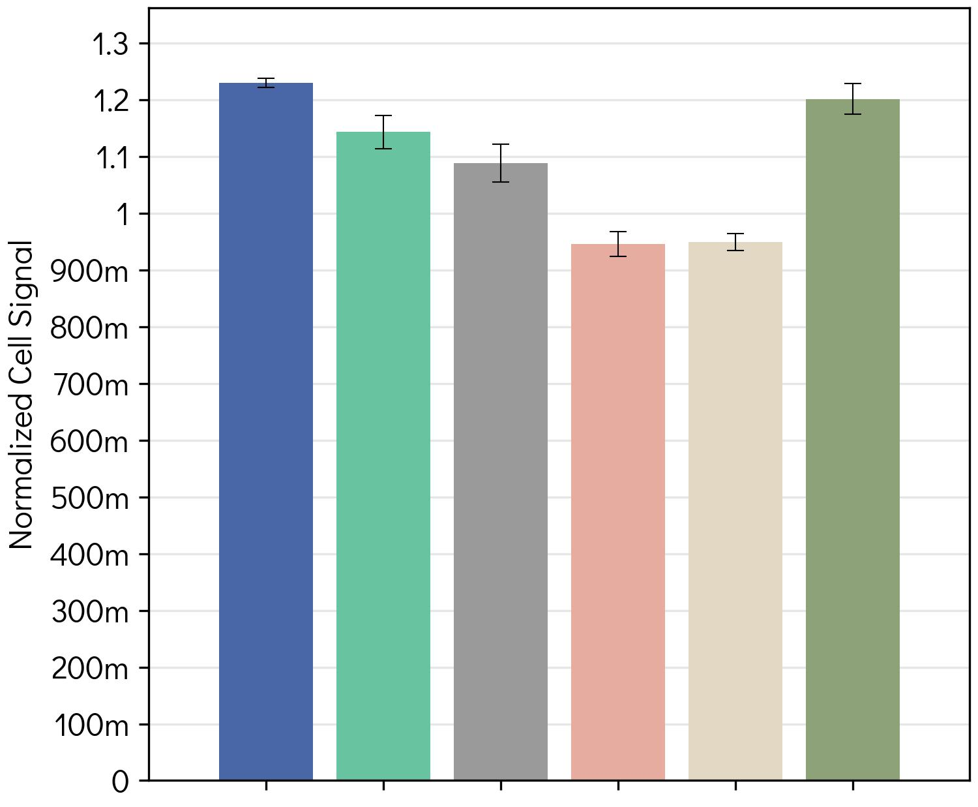

Results
Effect of cell density on impedance
Continuous impedance measurement of different cell densities
Impedance values of different cell densities after 7 days of experiment start
0k cells/well
1k cells/well
2.5k cells/well
5k cells/well
10k cells/well
Medium
Day 4
0k cells
1k cells
10k cells
Medium
Day 1
Day 7
2.5k cells
Medium change
Cell viability assay
5k cells

Slide 22
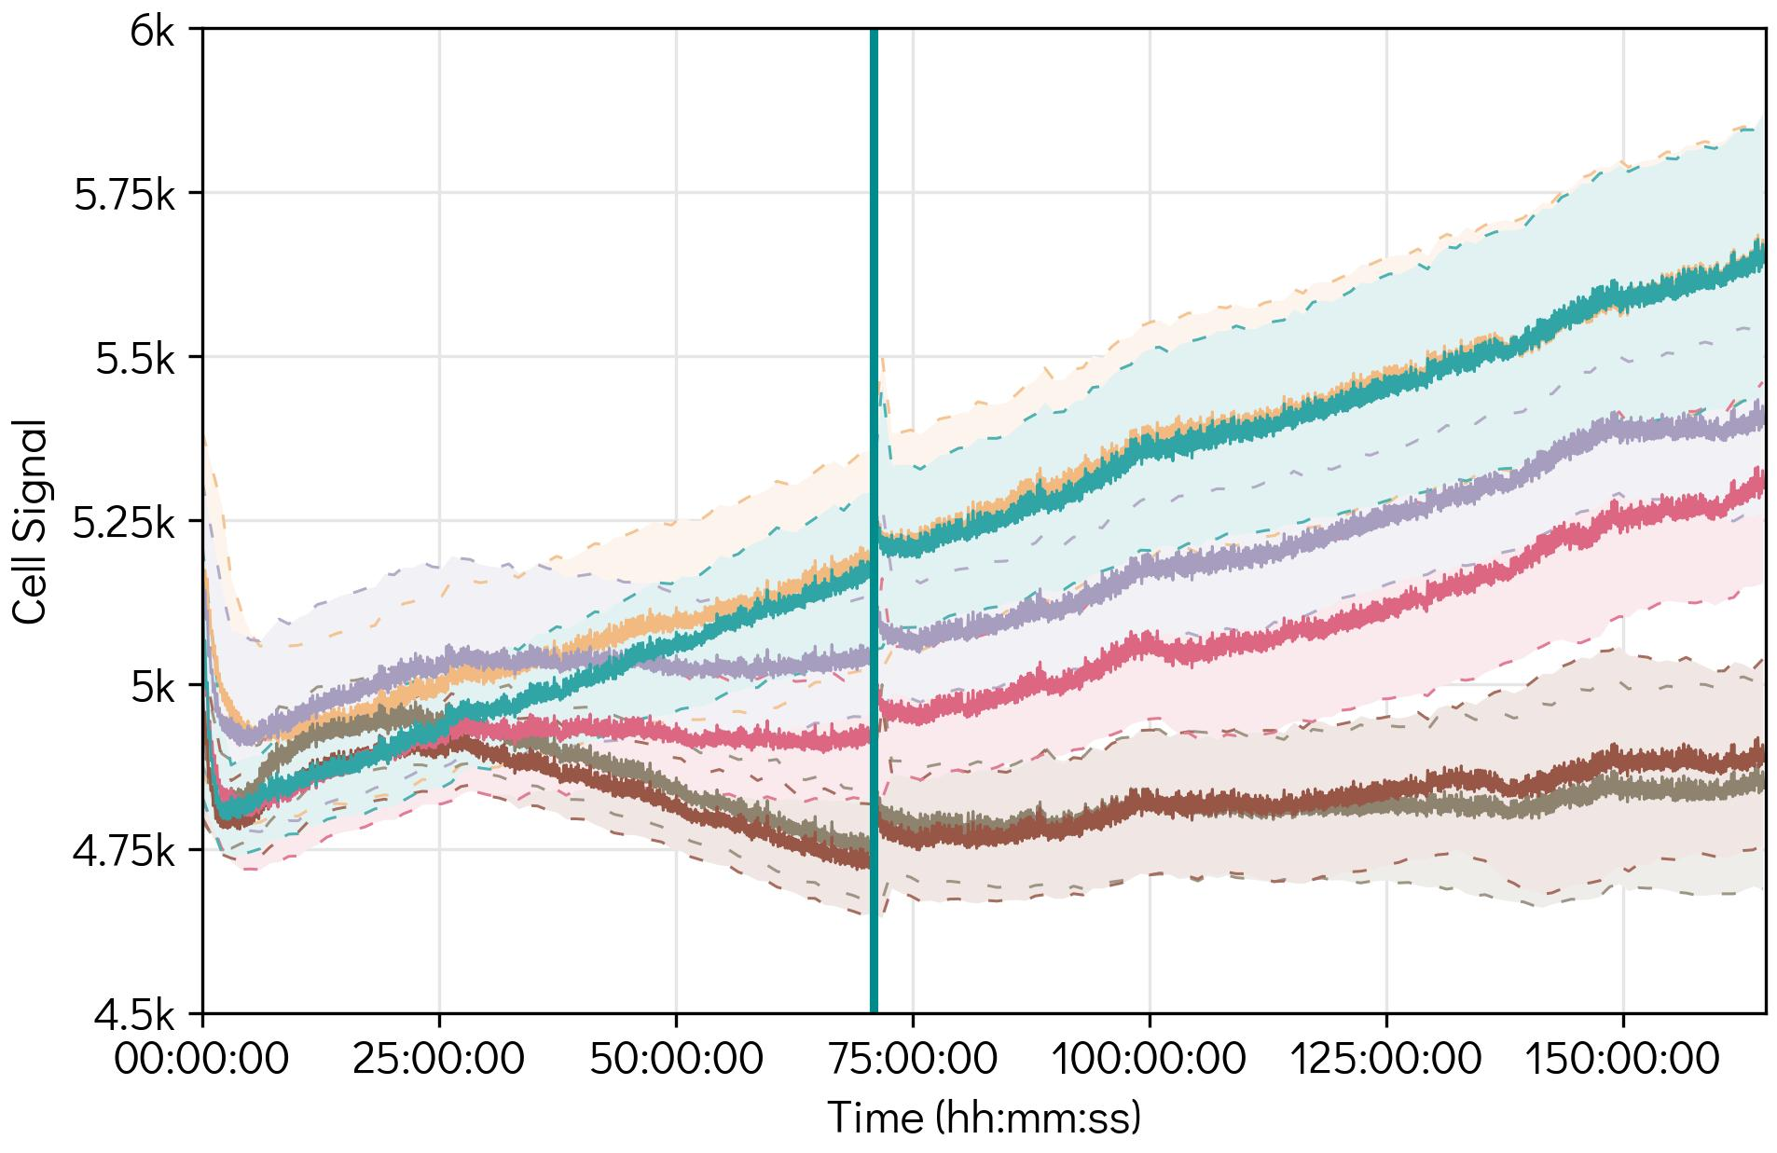
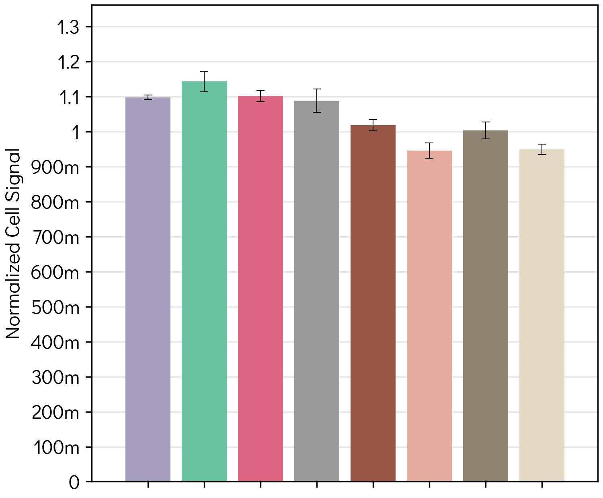

Results
Effect of drug treatment on impedance
Continuous impedance measurement of drug-treated cells
Impedance values of drug-treated and untreated cells after 7 days of experiment start
0k cells/well
1k cells/well
2.5k cells/well
5k cells/well
10k cells/well
Medium
Day 1
Day 4
Day 7
1k cells
2.5k cells
5k cells
10k cells
Medium change, addition of CM
1k cells + CM
2.5k cells + CM
5k cells + CM
10k cells + CM

Slide 23
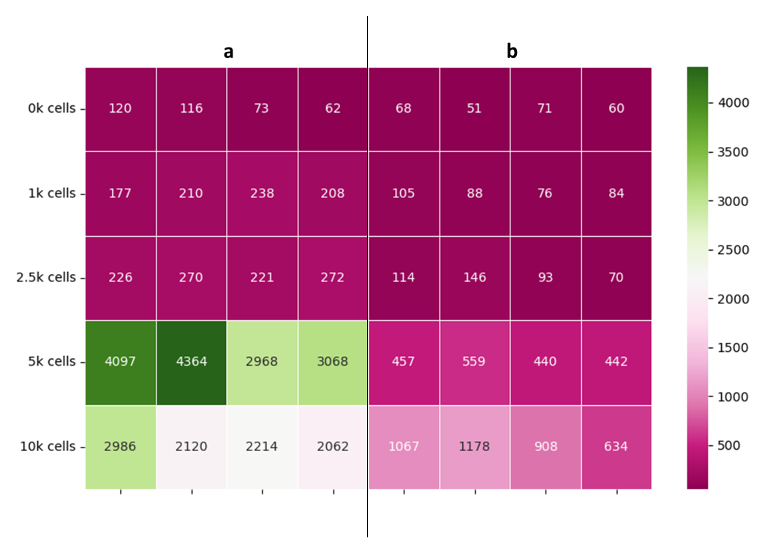
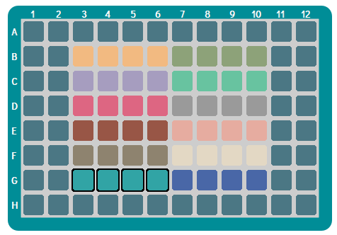
Results
Endpoint measurement: Viability assay (Resazurin assay)
Plate layout
Results of the Resazurin assay
Without drug treatment
With drug treatment
Without drug treatment
With drug treatment
0k cells
1k cells
2.5k cells
5k cells
10k cells

Slide 24
Summary and Outlook
Key Takeaways:
Inconsistent Impedance vs. Viability Trends: Resazurin assay shows increased viability with cell density, but impedance does not follow this pattern.
Cycloheximide’s Impact on Impedance & Metabolic Activity: Viability assay indicates reduced cell function with cycloheximide, but impedance remains inconsistent at higher densities.
Outlook:
Investigating the Impact of Environmental Conditions on Impedance.

Slide 25
Monitoring Patient-Derived Organoids from Malignant Pleural Effusion

Slide 26
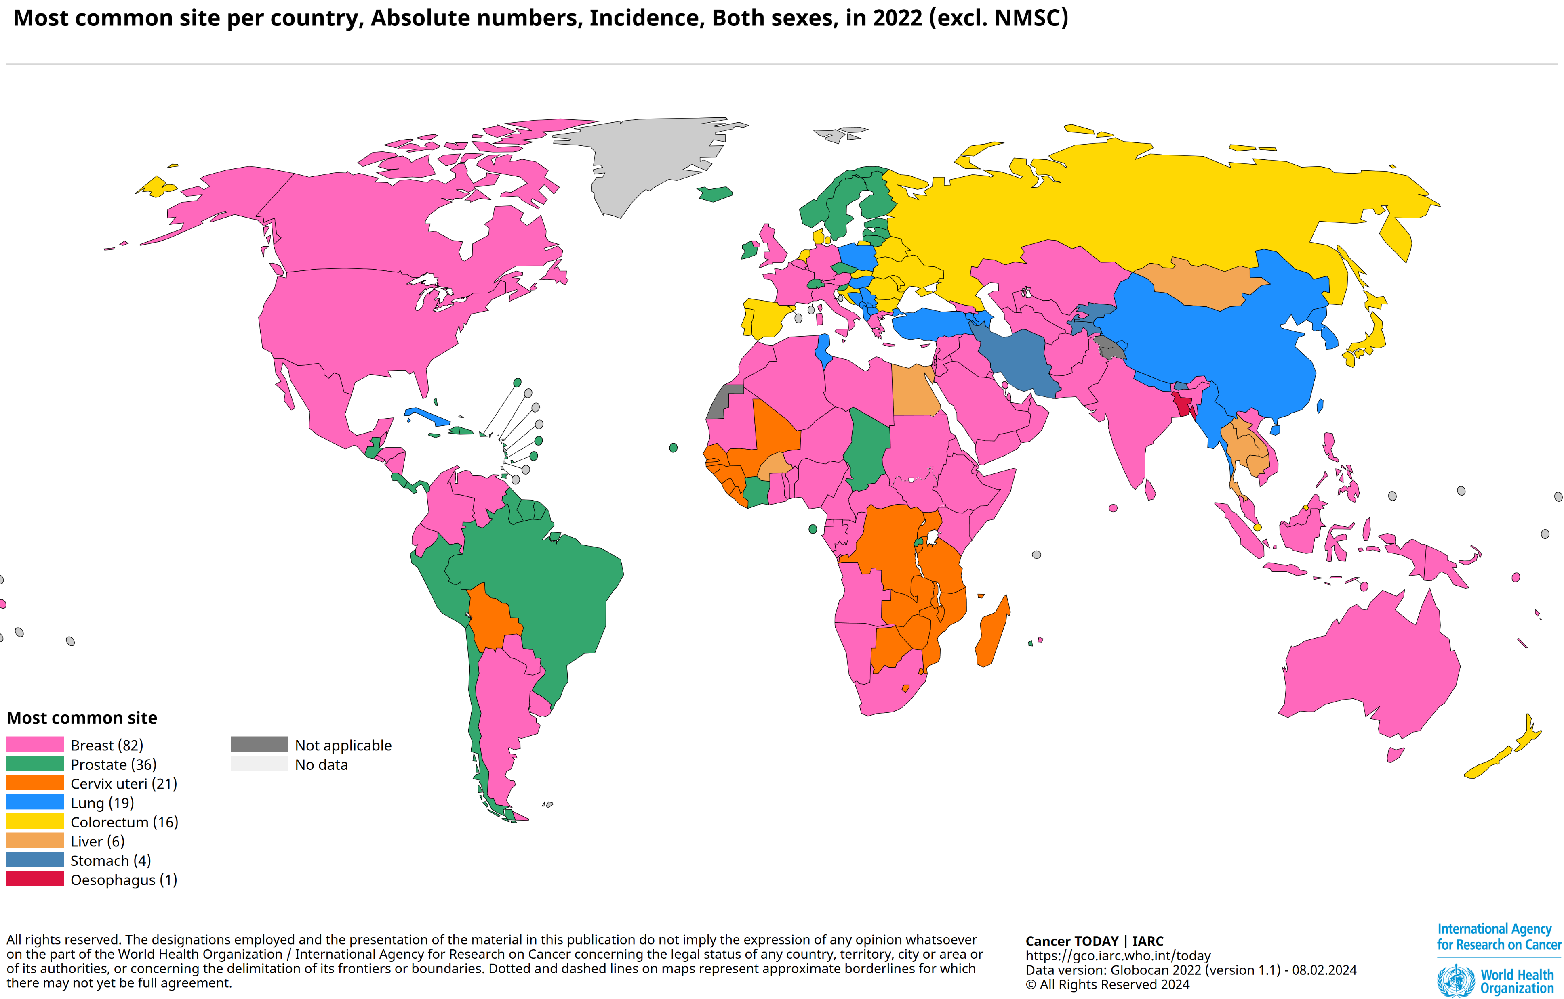
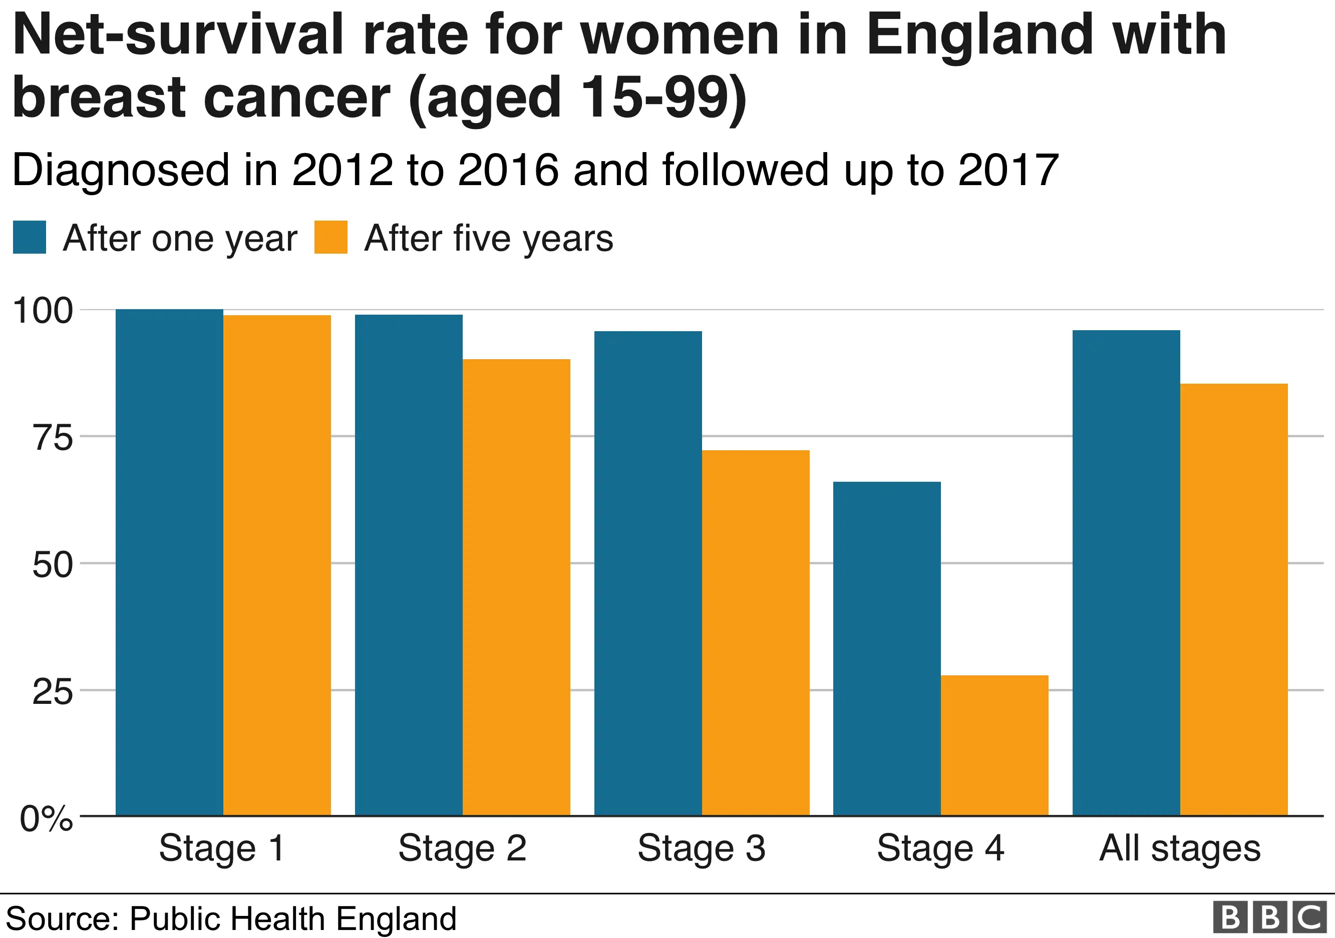
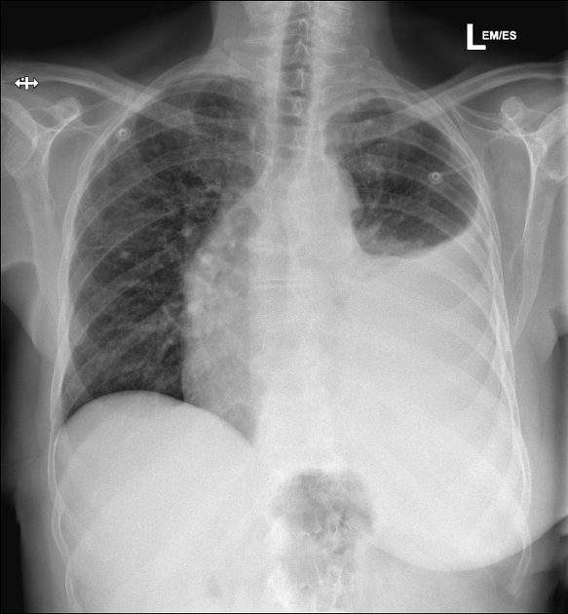
Introduction
Breast Cancer: The challenge
Malignant Pleural Effusion (MPE)
7% of BC patients develop MPE (presence of malignant cells in the peritoneal and pleural cavity in form of fluid).
Patients endure a poor quality of life defined by chest and abdominal pain and difficulty breathing.
Median survival rate: between 5 to 13 months.
Therapies often based on primary tumor, not metastatic lesion.
MPE samples provide metastatic tumor cells for modeling
Challenges in Culturing MPE-Derived Organoids: Low passaging success rates — typically below 50%.
v
https://radiopaedia.org/cases/malignant-pleural-effusion-1
https://www.bbc.com/news/health-47193545

Slide 27
Objectives
Optimize the culture conditions for malignant pleural effusion (MPE)-derived organoids.
Establish a biobank of MPE-derived organoid lines with diverse morphologies.

Slide 28
Project Plan
Next Steps
04.
Experimental Validation
Completed Work
01.
Literature Review
Passaging Organoids
Optimizing Culture Conditions
Monitoring Cellular Markers
02.
Selection of Medium Recipes
05.
Establishing a Biobank of Metastasized Breast Cancer Organoids
03.
Organoid Culture Setup
Expansion of Organoid Lines
Characterization of Morphologies
Documentation and Cataloging

Slide 29
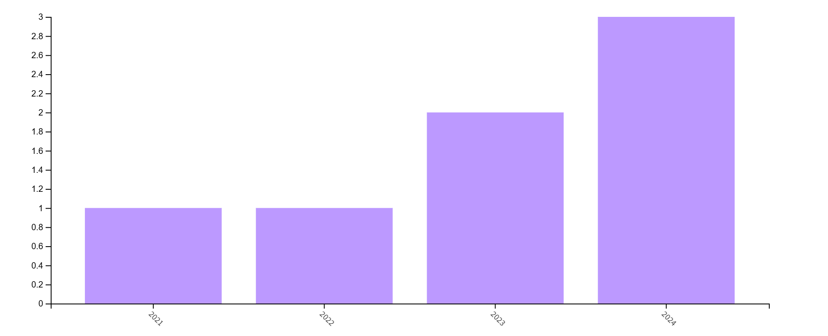
Literature Review
Trends in Publications on Malignant Pleural Effusion and Organoids (2021-2024): Web of Science Database

Slide 30
Thank you for your attention!

Slide 31
Annex

Slide 32
Post Hoc Test - Tukey's HSD: Specific cell density comparisons revealed significant differences in impedance:
Density comparison | Statistically significant difference
Density 0k vs. Medium | No
Density 0k vs. Density 1k | No
Density 1k vs. Density 2.5k | No
Density 10k vs. Density 5k | No
Density 1k vs. Medium | No
Density 0k vs. 2.5k, 5k, and 10k | Yes
Density 10k vs. Density 1k, 2.5k and Medium | Yes
Density 1k vs. Density 5k | Yes
Density 2.5k vs. Density 5k and Medium | Yes
Density 5k vs. Medium | Yes
Aziza Guellouz | Dynamic Readout Modalities for 3D Cell Models

Slide 33
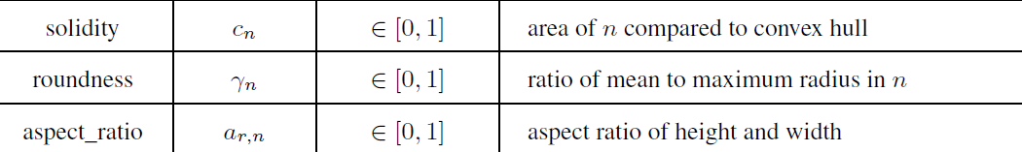
Features

Slide 34
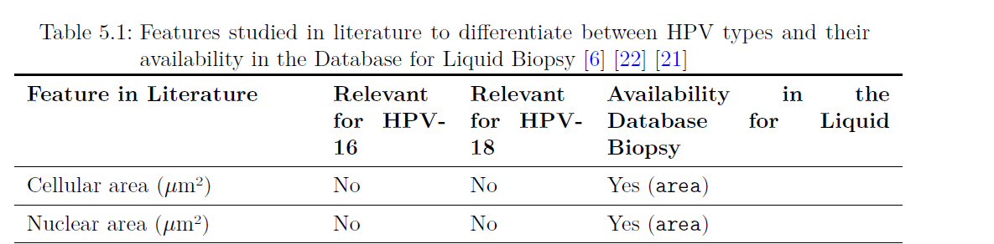
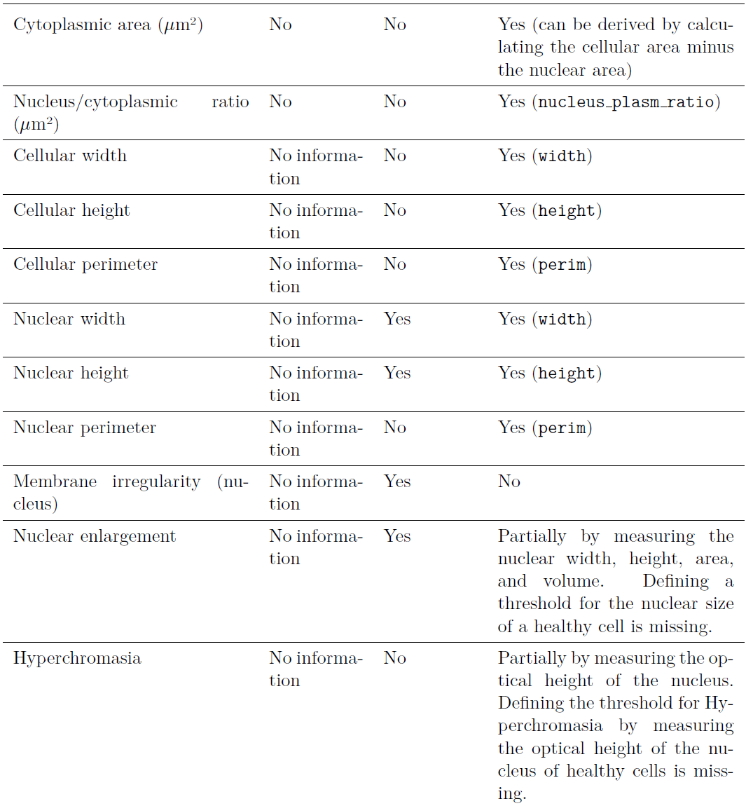
Features

Slide 35
Features

Slide 36
Features

Slide 37
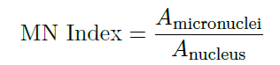
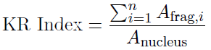
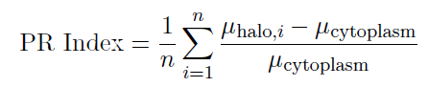
Micronuclei (MN) | Karyorrhexis | Prenuclear Halo
Small, extranuclear bodies formed from chromosomal fragments or whole chromosomes that are excluded from the main nucleus during cell division | Karyorrhexis involves the fragmentation of the nucleus into smaller fragments, often a sign of nuclear degradation. The degree of nuclear fragmentation can be quantified by calculating the ratio of the total area of the nuclear fragments to the area of the nucleus | Cells with perinuclear halo are characterized by a clear halo or empty region around the nucleus, a common marker in cells affected by viral infections or certain cancers. The detection of a perinuclear halo can be achieved by comparing the optical density of the cytoplasm surrounding the nucleus to the overall cytoplasmic density.
(a) Binucleated (BN) and koilocytotic (KC) cells (b) Nuclear budded (NB)
and koilocytotic epithelial cells (KC) (c) Micronucleated cervical epithelial
cell (MN) and exfoliated cervical epithelial cells (d) Karyorrhectic (KR) epithelial
cells (e) Karyolytic cells (KL) (f) Exfoliated epithelial cells with round
nuclei with perinuclear halo (PR) in liquid-based cervical cytology samples.
Zehra Safi Oz, Figen Barut, Furuzan Kokturk, and Banu Dogan Gun. The structural
profile of hpv 18 in terms of chromosomal and nuclear degenerative changes and the
ratio of nucleus/cytoplasm on liquid based cervical cells. Journal of Cytology, 40
(3):133–139, 2023. doi: 10.4103/joc.joc 72 22. Published online 2023 Aug 14.
Aziza Guellouz | Dynamic Readout Modalities for 3D Cell Models

